Slide 1
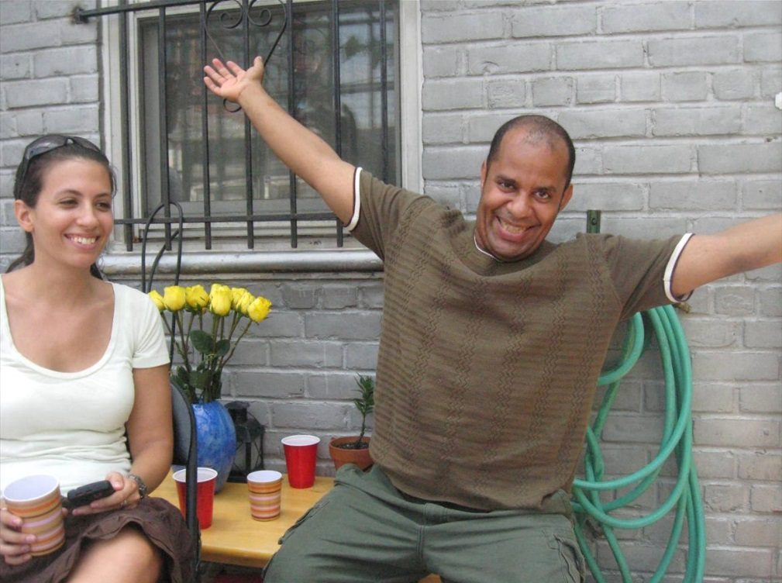
Supported Decision Making State Law, Case Law, Professional Standards & Pilot Projects
AAIDD National Conference June 2016

Slide 2
How is SDM Being Adopted in the U.S.?
State passes law
Court decisions set precedent
Professional Associations revise standards
SDM pilot projects and evaluations advance knowledge of what is possible & where systems need further change

Slide 3
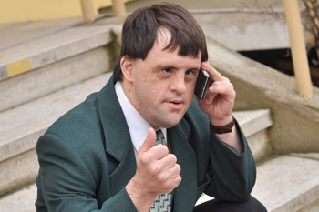
Legislation
Your state can pass legislation to recognize SDM and how it is to work.

Slide 4
Texas - First SDM law in U.S. !!
2015 - Texas amended guardianship statute to incorporate SDM.
Law requires alternatives be considered - including SDM and using power of attorney and person centered planning, etc. - prior to imposing guardianship.
Requires training for court-appointed attorneys in guardianship proceedings, including alternatives and supports and services.
Petitions for guardianship need to indicate alternatives, supports and services considered (power of attorney, representative payee, dual signature on bank account, etc.) and if these would avoid need for guardianship. Requires finding by court that alternatives were considered.

Slide 5
Texas - First SDM law in U.S.
Appears to provide safe harbor for third parties who rely on SDM Agreement.
Affirms use of formal and informal supports, services and assistance can help an individual meet their basic needs, physical or mental health needs, financial affairs and personal decisions.
Presumes incapacitated person retains capacity to make personal decisions. Requires specific findings of necessity before removing person’s right to make personal decisions about where they live, voting, operating motor vehicle, marriage.

Slide 6
Texas - First SDM law in U.S.
Great SDM Representation Agreement form that does not require court approval.
Law recognizes a freely chosen supporter as someone who will provide decision making assistance but not make decisions for a person.
Excerpt: “My supporter does not make decisions for me. My supporter may: 1. Help me get information for medical, psychological, financial, or educational decisions; 2. Help me understand my choices so I can make the best decision for me; or 3. Help me tell people my decision.
Model for other states

Slide 7
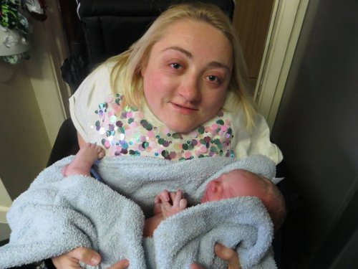
2. Case Law
Judges have overturned guardianships
and refused to impose guardianship in
recognition of SDM.

Slide 8
1991 Pennsylvania case
Brother filed guardianship petition of his 60 year-old sister. Ms. Peery placed under guardianship. Appealed to state’s higher court.
Superior Court ruled lower court erred by failing to make separate findings required by law: (1) person’s incapacity and (2) need for a guardian. Sent case back to conduct a hearing on need for guardian.
Lower court found Ms. Peery’s I.Q. low but this did not render her incapable of self-care. It required her to depend on others in regard to health, welfare, safety, and medical needs. Court found her needs were being met with the help of individuals already assisting her. Judge impressed with her support system, caretakers extremely devoted and reliable. Judge examined Ms. Peery’s preferences, and found she was satisfied with her life and current supports, and she did not wish to see her brother.
Notes:
Many state guardianship statutes are configured this way, separating out 2 issues. Need for guardian only if the specific incapacity places person at risk of harm.

Slide 9
1991 Pennsylvania case
Court decision - Guardianship unnecessary as services were already available to her meet the essential requirements for her physical health, safety, and for managing her financial resources.
“This Court need not look to whether Ms. Peery can manage her personal financial resources or meet essential requirements for health and safety on her own. Rather, the proper inquiry is whether Ms. Peery has in place a circle of support to assist her in making rational decisions concerning her personal finances and to meet essential requirements of health and safety. This Court will not disturb Ms. Peery's wishes as long as her decisions are rational and result in no perceivable harm to her.”

Slide 10
2012 New York case
Mother of 29 yo woman (Dameris) with mild to moderate ID filed petition for guardianship. Petition noted “functioning at the mental age of a 7 year old...poor receptive and expressive skills, [and, while] ambulatory and able to care for most of her grooming needs, she is highly dependent for all other needs, including medical and financial matters.” Dameris attended a day habilitation program learning cleaning tasks, particularly bathrooms.
2 weeks later Dameris married a man with a history of substance abuse, mental illness and criminal charges.
Mother requested expedited consideration of petition because Dameris was pregnant and due to give birth.
Parties went to mediation & agreed Dameris would live with husband, her mother given substantial role after baby’s birth, and husband and mother were appointed co-guardians for Dameris.

Slide 11
2012 New York case
Baby born. Couple and child lived in temporary homeless housing then lost it when funding cut. Husband arranged move out of state to home near his cousin. Cousin’s family provided many supports.
In PA their social network expanded. Neighbors became friends and helpers, some godparents. Damaris started literacy classes. Social worker became part of her informal decision support. Damaris’ mother involved again.
When baby 3 yo, Dameris pregnant again. She planned a tubal ligation & made decision after consulting husband, health care professionals, and members of husband’s family.
Husband petitioned to end guardianship. Judge found Damaris to have and use multiple decision supports, “Proof that a person with an intellectual disability needs a guardian must exclude the possibility of that person’s ability to live safely in the community supported by family, friends, and mental health professionals.”
Notes:
“Finally, Alberto spoke about what he had accomplished with Dameris over the past eight 8 months in their new home— the progress she had made, what a good job she was doing now with two children, and how together they had found and utilized a support system that was helping them succeed despite all the difficulties they faced. He spoke movingly of his respect for Dameris, and how he understood his role, not as deciding for her, but in assisting her in making her own decisions.”
“The family is now fully settled in Pennsylvania, as opposed to the temporary move the court previously authorized. As such, with Cruz suspended, and giving consent to termination of the guardianship, the court no longer has jurisdiction over Dameris. But, even if this were not the case, I would find that guardianship is no longer warranted because there is now a system of supported decision making in place that constitutes a less restrictive alternate to the Draconian loss of liberty entailed by a plenary 17-A guardianship. This use of supported decision making, rather than a guardian’s substituted decision making, is also consistent with international human rights, most particularly Article 12 of the United Nations Convention on the Rights of Persons with Disabilities (CRPD).”
“The instant case provides a perfect example of the kind of family and community support that enables a person with an intellectual disability to make, act on, and have her decisions legally recognized as, for example, by acceptance of her “informed consent” to a tubal ligation. Because Dameris has such assistance, she is now able to engage in supported decision making, rather than having substituted decision making, in the form of guardianship, imposed upon her by the court.
The internationally recognized right of legal capacity through supported decision making can and should inform our understanding and application of the constitutional imperative of least restrictive alternative. That is, to avoid a finding of unconstitutionality, SCPA 17-A must be read to require that supported decision making must be explored and exhausted before guardianship can be imposed or, to put it another way, where a person with an intellectual disability has the “other resource” of decision making support, that resource/network constitutes the least restrictive alternative, precluding the imposition of a legal guardian.

Slide 12
2013 Virginia’s famous Jenny Hatch case
Mother & step-father of 29 year old woman with Down syndrome petitioned for guardianship. Jenny objected to guardianship and decisions parents were making for her (group home, sheltered workshop, no phone, no laptop, no visits with friends). At trial, Jenny presented her preferences and supporters she utilized for decisions.
Judge named a couple Jenny chose to support her as temporary limited guardians for 1 year, with goal of transitioning to SDM. Temporary guardianship expired in August 2014.
Jenny Hatch Justice Project website: http://jennyhatchjusticeproject.org/trial
Notes:
The court denied the guardianship petition, naming the friends Ms. Hatch chose to support her as temporary limited guardians for one year, “with the . . . goal of transitioning to the supportive [sic] decision making model. ”The court charged the temporary guardians to “assist [Ms. Hatch] in making and implementing decisions we have heard termed ‘supported decision making.’”

Slide 13
2015 Massachusetts case
Cory is 25 years old and participating in a SDM pilot in MA. He loves music and cars; he is diagnosed with autism and psychiatric disabilities.
Under full guardianship since he was 18, he also had a Roger’s monitor for antipsychotic medication decisions.
He asked court to remove (discharge) guardianship & Roger’s for SDM. Judge’s order, "The SDM Agreement provides to Mr. C. a sensible, reasonable and workable arrangement to assist him to make his own decisions about all aspects of his life."
His mother, father & sister are SDM decision supporters.

Slide 14
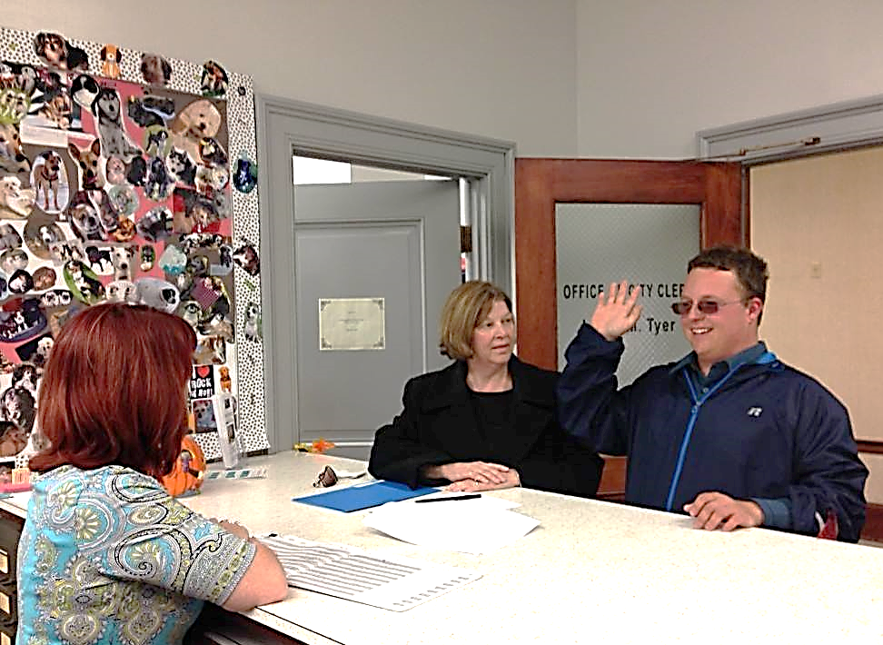
2015 Massachusetts case
Cory’s mother described SDM as the right fit, “We always wanted an alternative to guardianship from the beginning, but there was not such an option at the time when Cory turned 18. We are happy Nonotuck and CPR stepped up to meet this need for families and their loved ones.”
Cory at town hall having SDM Agreement notarized. http://supporteddecisions.org

Slide 15
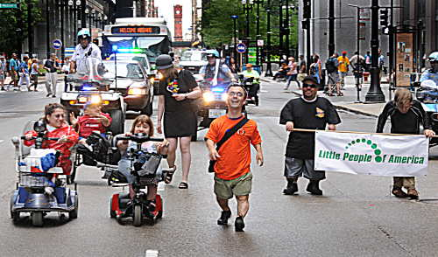
Professional Associations
Changing Standards of Practice
Disability Pride Parade, Chicago

Slide 16
National Guardianship Association Revised Standards
2013 – NGA changed standards to best practice. Some standards go beyond state law requirements.
Standard 7 – Standards for Decision-Making
Guardian shall identify and advocate for the person’s goals, needs, and preferences. Specifies steps, including:
1st - Ask person what he or she wants
2nd - Do everything possible to help person express goals, needs, and preferences.
3rd - Only if person even with assistance is unable to convey preferences, then seek input from others who know person well to determine what person would want.

Slide 17
National Guardianship Association Revised Standards
Standard 9 – Self-Determination of Person
Guardian shall attempt to maximize the self-reliance and independence of the person.
Guardian shall encourage person to participate, ...in all decisions that affect him or her, to act on his or her own behalf in all matters in which person is able to do so, and to develop or regain his or her own capacity to maximum extent.
Shall ensure the person leads planning processes; or at a minimum, participates.

Slide 18
National Guardianship Association Revised Standards
Standard 10 – Duties Regarding Diversity and Personal Preferences of Person
Guardian shall determine extent to which person identifies with particular ethnic, cultural, religious values and apply those when considering decisions.
Ensure person’s right to consensual sexual expression, to privacy and accommodations for sexual expression, to be informed of birth control options.
Notes:
NGA Standard 10 – The Guardian’s Duties Regarding Diversity and Personal Preferences of the Person
Re values, the guardian shall also consider the following:
The person’s attitudes regarding illness, pain & suffering
The person’s attitudes regarding death & dying
The person’s views re quality of life issues
The person’s views re societal roles and relationships
The person’s attitudes re funeral and burial customs

Slide 19
National Guardianship Association Revised Standards
Standard 12 – Termination & Limitation of Guardianship
Guardian shall assist the person under guardianship to develop or regain the capacity to manage personal or financial affairs
Shall seek termination or limitation of the guardianship when:
Person develops or regains capacity
Less restrictive alternatives exist
Person expresses the desire to challenge all or part of the guardianship....

Slide 20
Joint AAIDD-Arc Position Statement
2016 AAIDD adopted & Arc Board passed the Autonomy, Decision-Making Supports and Guardianship Position Statement
Statement: All individuals with intellectual and/or developmental disabilities (I/DD) have the right to recognition as persons before the law and to enjoy legal capacity on an equal basis with individuals who do not have disabilities in all aspects of life (United Nations Convention on the Rights of Persons with Disabilities (UN CRPD), 2006). The personal autonomy, liberty, freedom, and dignity of each individual with I/DD must be respected and supported.
Notes:
Adopted: American Association on Intellectual and Developmental Disabilities Board of Directors March 16, 2016 The Arc Board of Directors April 10, 2016 & may still need full membership vote

Slide 21
Joint AAIDD Arc Position Statement
Statement continued: Legally, each individual adult or emancipated minor is presumed competent to make decisions for himself or herself, and each individual with I/DD should receive the preparation, opportunities, and decision-making supports to develop as a decision-maker over the course of his or her lifetime.
Position excerpt: State laws should be reformed to prefer less intrusive alternatives to full guardianship, including limited guardianship, limited (and revocable) power of attorney or health care proxy, specifically tailored to individual need. These alternatives should always be considered first.”

Slide 22
Joint AAIDD Arc Position Statement
Position excerpt:
Regardless of their guardianship status, all individuals with I/DD retain their fundamental civil and human rights (such as the right to vote and the right to make decisions related to sexual activity, marriage and divorce, birth control, and sterilization) unless the specific right is explicitly limited by court order.

Slide 23
Joint AAIDD Arc Position Statement
Position excerpt:
If legal limitations on autonomy are necessary, then National Guardianship Association or equivalent standards that are consistent with the values expressed in this position statement should be followed. If any restrictions on autonomy are legally imposed, each individual has the right to the least restrictive alternative, due process protections, periodic review, ongoing training and supports to enhance autonomy and reduce reliance on approaches that restrict individual rights, and the right to ultimately seek to restore rights and terminate the restriction when possible.

Slide 24
American Bar Association 2016
PRESUME guardianship is not needed.
REASON. Clearly identify the reasons for concern.
ASK if a triggering concern may be caused by temporary or reversible conditions. Look for steps to reverse the condition or postpone a decision until the condition improves.
COMMUNITY. Determine if concerns can be addressed by connecting the individual to family or community resources & making accommodations. Ask “what would it take?” to enable the person to make the needed decision(s) or address the presenting concern.
Notes:
A joint product of 4 American Bar Association entities – the Commission on Law and Aging, Commission on Disability Rights, Section on Civil Rights and Social Justice, and Section on Real Property, Trust and Estate Law, with assistance from the National Resource Center for Supported Decision-Making.
“PRACTICAL” is an acronym for 9 steps for lawyers to identify these options. The lawyer can use the PRACTICAL checklist of steps during the client interview and immediately after to assist in case analysis. The steps blend in naturally with the case interview process. Lawyers serving in different roles may use the steps differently. The PRACTICAL Tool offers concrete steps to implement the least restrictive alternative principle as a routine practice of law. The PRACTICAL Tool Resource Guide describes each of the nine steps, offering examples and including hyperlinks to key materials and community resources.

Slide 25
American Bar Association 2016
TEAM. Ask the person whether he or she already has developed a team to help make decisions.
IDENTIFY abilities. Identify areas of strengths and limitations in decision-making if the person does not have an existing team and has difficulty with specific types of decisions.
CHALLENGES. Screen for and address any potential challenges presented by the identified supports and supporters.

Slide 26
American Bar Association 2016
APPOINT legal supporter or surrogate consistent with person’s values and preferences.
LIMIT any necessary guardianship petition and order.
Available at:
http://www.ambar.org/practicaltool

Slide 27
Pilot Supported Decision Making Initiatives
Texas Pilot - University of TX at Austin, School of Law, William Wayne Justice Center
Massachusetts Pilot – Center for Public Representation (law firm) & Nonotuck Resource Associates (provider agency)

Slide 28
SDM Pilot University of Texas at Austin, Law School
INCLUDE - Sponsored by the William Wayne Justice Center for Public Interest Law that works to advance the rights of persons with disability and the involvement of law students in the disability rights movement.
2014-15 pilot targeted parents and students with disabilities in special education transition programs (young adulthood) for counseling about SDM and other alternatives to guardianship.
Outreach conducted to hundreds of families across 8 central Texas school districts. 102 families also received one-to-one counseling with law students under supervision.
10 families adopted SDM. Outcomes associated with the deferral of guardianship and use of SDM will be studied.
Notes:
Parents of students in this age-range were targeted because a very large number of new guardianships created annually in Texas are sought by the parents of those who come of age within special education program
Helen Gaebler (Senior Research Attorney) and Lucy Wood (Clinical Professor) are attorneys with the Center initiating a SDM pilot. They are focusing on transition age youth (17 & 18 yo) with I/DD, most of them with autism who are low income. Twenty families and individuals are considering SDM.
The University of Texas at Austin | School of Law

Slide 29
Texas Pilot: Comments from Youth about SDM
Q: What do you think about all of this stuff? A: “I think it’s fun. I think it’s cool!”
Q: Do you want a guardianship? A: “NOT guardianship, takes away my rights. I make my own choice.” Mom/Supporter: “And we can step in and help.”
Q: If you want to live somewhere and your mom disagrees, who gets the final say? A: “I do, but I’ll listen to my mom if she wants to help. She might not like it, but I get to make decisions.”
Q: What kind of job are you looking for? A: “I want to work with kids who have cancer.” Q: What if your mom wants you to work in the zoo? A: “I will tell her I want to work in the hospital because it’s my choice.”
Q: What’s a guardian? A:“Hard for me to explain. Seems like a guardian controls decisions. I want to make decisions on my own, but I want help with the important decisions of my life.”
[Source: INCLUDE document.]

Slide 30
Massachusetts SDM Pilot
Partnership between CPR & Nonotuck Resource Associates
Individuals with I/DD enter into Agreements with supporters in areas such as health, relationships, finances, employment
CPR provides legal representation as necessary
Nonotuck care managers act as liaisons between the individual, his/her network and the community
Advisory Council reviews progress, offers guidance
Independent evaluation by HSRI
2 year pilot and evaluation (2014-16)

Slide 31
SDM Pilot Advisory Council
Representatives include:
HSRI Evaluation Recommendation
People using services
Legal scholars in disability issues
Judges
Attorneys
Medical professionals
Directors of human service organizations
Hold Initial Planning Meeting
Set aside time to discuss the SDM initiative framework, resources needed, and foreseeable implementation issues with pilot staff and a larger stakeholder group such as an Advisory Council.
Create a shared vision of pilot and goals. Include why retaining decision-making rights matters to people with disabilities and our society in general.

Slide 33
8 Pilot Participants Demographic Info
Age | 24 to 79 years. When pilot initiated, age range was 23 to 78 years.
Gender | 5 females, 3 males
Primary means of communication | All use speech but there is vocal expression range: 1 uses “yes” and “no” with facial expression 1 relies heavily on text messaging 1 needs a lot of time to process information and respond
ID diagnoses | 2 Mild intellectual disability, 5 Moderate intellectual disability
Behavioral health diagnoses | 1 Borderline personality disorder, history of suicidal preoccupation 2 Bipolar mood disorder 4 Anxiety disorder 2 Depression/dysthymia 1 ADHD (attention deficit hyperactivity disorder) 1 Psychotic disorder 1 Post-traumatic stress disorder (PTSD)
Home | All live with caregivers using a shared living model. 3 have decades-long residential histories in Massachusetts state institutions
Guardian status | 2 had full guardians, 1 discharged thus far

Slide 34
Amanda’s SDM Arrangement
Decision Support Areas:
Health care, Legal, Finances, Home and Personal Life
Chose 4 Supporters:
Mother
Live in caregiver since 2009
Respite worker-friend
Care Manager-friend- respite worker

Slide 36
HSRI Evaluation Findings Year 1: Decision Supporters
Shared living is a model that offers SDM adopters a community member they trust to serve as decision supporter.
When more than 1 decision supporter is selected, describe in SDM agreement how consultation is to work.
Take precautions so individuals understand they can specify types of decisions for support and decisions types they want to make without using SDM.

Slide 37
HSRI Evaluation Findings Year 1: Safeguards
Institute procedures to:
Periodically remind SDM participants and decision supporters of the ability to change decision supporters and areas for decision assistance.
Examine any complaint concerning a decision supporter.
Refer any suspected abuse, neglect, or financial exploitation for swift investigation.

Slide 38
HSRI Evaluation Findings Year 1: Safeguards
Incorporate safeguards into SDM initiatives such as no-cost, voluntary adoption; free legal assistance; withdrawal from the pilot at any time for any reason; and care manager monthly monitoring of SDM adopters’ satisfaction with SDM.
Establish a protocol with frequency and a responsible entity to periodically communicate to SDM adopters their freedom to withdraw from the pilot without repercussion.
When a representative payee and SDM are both in place for financial decision support, periodically reexamine the need for the representative payee.

Slide 39
Michael Kendrick, International Consultant
“One of the great wisdoms in life is that once you’ve made a bad decision, not to keep making it. SDM allows us to correct our course, our mistake in removing peoples’ voice.
It’s important to set things right.”
Notes:
Stated during the SDM celebratory event in November 2015 after Cory’s successful day in court.

Slide 40
References and Resources
AAIDD Position Statement, Autonomy, Decision-Making Supports, and Guardianship: http://aaidd.org/news-policy/policy/position-statements/autonomy-decision-making-supports-and-guardianship#.V1Bm9dUrK2w
Massachusetts SDM Pilot website: www.supporteddecisions.org
National Guardianship Association Standards: http://www.guardianship.org/documents/Standards_of_Practice.pdf
New York Demaris case, court order: http://www.americanbar.org/content/dam/aba/administrative/mental_physical_disability/dameris.authcheckdam.pdf
Pennsylvania Peery case, In re Peery, 727 A.2d 539, 540 (Pa. 1999).
Practical Tool for Lawyers: Steps in Supported Decision Making: http://www.ambar.org/practicaltool
Texas SDM statute: http://www.capitol.state.tx.us/Search/DocViewer.aspx?ID=84RHB000395B&QueryText=supported%2bOR%2bguardian&DocType=B

Slide 41
References & Resources
continued
Contact Information
Elizabeth Pell, Policy Associate
Human Services Research Institute (HSRI)
epell@hsri.org
617.876.0426 x 2307
www.hsri.org
Texas SDM Representation Agreement: http://supporteddecisions.org/wp-content/uploads/2015/09/Texas.Simplified-Supported-DecisionMaking-Form.pdf
Texas INCLUDE pilot: Lucy Wood, (512) 626-2060, lwood@law.utexas.edu
Virginia case: Ross v. Hatch, No. CWF120000426P-03, slip op. at 7 (Va. Cir. Ct. Aug. 2, 2013)

