Slide 1
Everyone Can Self-Direct: Lessons Learned from the NCAPPS Self-Direction Learning Collaborative
January 17, 2024
Notes:
Notes Page Title Here
(edit this in notes view)

Slide 2
Welcome to Today’s Webinar
Thank you for joining us to explore lessons learned from the NCAPPS Self-Direction Learning Collaborative.
Today’s webinar is sponsored by the National Center on Advancing Person-Centered Practices and Systems (NCAPPS).
NCAPPS is funded by the Administration for Community Living (ACL) and the Centers for Medicare and Medicaid Services (CMS) and administered by the Human Services Research Institute (HSRI).
NCAPPS webinars are free and open to the public.
Bevin Croft
Saska Rajcevic
bcroft@hsri.org
srajcevic@hsri.org
NCAPPS Co-Director at HSRI
NCAPPS Co-Director at HSRI

Slide 3
The Goal of NCAPPS
To promote systems change that makes person-centered principles not just an aspiration but a reality in the lives of people across the lifespan.
Priorities:
Centering lived experience
Partnering with advocacy communities
Disability justice and racial equity
Cultural humility and competence
Cross-system collaboration

Slide 4
Webinar Logistics
Participants will be muted during this webinar. You can use the chat feature in Zoom to ask questions and communicate with the hosts.
Towards the end of the webinar, panelists will have an opportunity to respond to questions that have been entered into chat.
The webinar will be live captioned in English and live interpreted in Spanish.
Live English captions can be accessed by clicking the “CC” button at the bottom of your Zoom screen.
Live Spanish interpretation can be accessed by clicking the “interpretation” button at the bottom of your Zoom screen (world icon). Once in the Spanish channel, please silence the original audio.
Se puede acceder a la interpretación en español en vivo haciendo clic en el botón "interpretation" en la parte inferior de la pantalla de Zoom (icono del mundo). Una vez en el canal español, por favor silencie el audio original.
This live webinar includes polls and evaluation questions. Please be prepared to interact during polling times.

Slide 5
Feedback and Follow-Up
Follow-up questions and feedback about the webinar can be addressed to ncapps@hsri.org. This email address is not monitored during the webinar.
NCAPPS webinars are not officially approved for Continuing Education Units (CEUs). However, we do provide a confirmation of attendance in case an organization wishes to use participation in our webinars to grant credit for internal requirements. Zoom will automatically send attendees a confirmation of attendance one day after the webinar.
All registrants will receive a link to the webinar recording and other materials such as slides and resources one day after the webinar.
NCAPPS webinars and associated materials such as plain language summaries and transcripts are archived on the NCAPPS website at https://ncapps.acl.gov/.

Slide 6
Who’s Here?
“In what role(s) do you self-identify? Select all that apply.”
Person with a disability/person who uses long-term services and supports
Family member/loved one of a person who uses long-term services and supports
Self-advocate/advocate
Peer specialist/peer mentor
Social worker, counselor, or care manager
Researcher/analyst
Community or faith-based service provider organization employee
Government employee
(federal, state, tribal, or municipal)

Slide 7
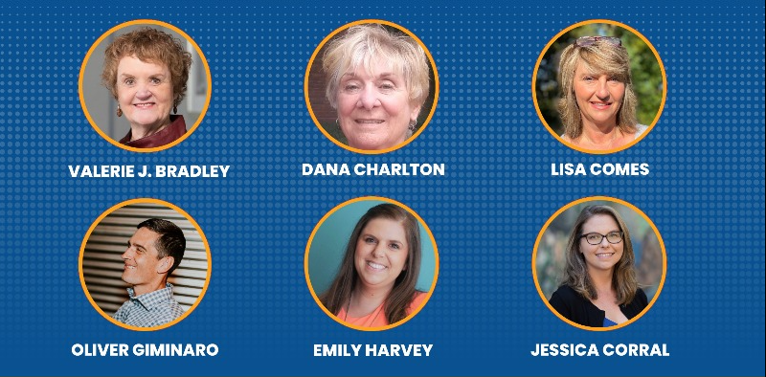
Meet Our Panelists

Slide 8
What is Self-Direction?
According to Applied Self-Direction:
Self-direction is a model of long-term care service delivery that helps people of all ages, with all types of disabilities, maintain their independence at home. When a person self-directs, they decide how, when, and from whom their services and supports will be delivered. As a model, self-direction prioritizes participant choice, control, and flexibility. This contrasts with ‘traditional’ services received from an agency, where the agency controls most aspects of service delivery, including who will provide the service. In self-direction, the participant selects and trains their own staff, develops their staff's schedules, and sets their own standards for how their services will be delivered.

Slide 9
Self-Direction is Person-Centered

Slide 10
Benefits of Self-Direction
During the pandemic, many individuals and families chose to self-direct their services to cope with closures of out-of-home programs or workplaces or to overcome staffing shortages.
There is a workforce crisis across human services and self-direction offers the possibility of tapping into a non-traditional workforce (e.g., friends, neighbors, family members).
Self-direction makes it possible to individually tailor services and supports rather employing a one size fits all approach and therefore has the potential of being more cost-effective.
Self-direction helps participants build decision-making skills and a support system in line with their goals and aspirations.

Slide 11
HOWEVER…
Based on data from the National Core Indicators 20-21 In-Person Survey, only 18% of respondents are self-directing
Further – the numbers of people self-directing by state ranged from 1% to 55%

Slide 12
THEREFORE…
The NCAPPS team determined that there is a need for a national effort to expand the quality and availability of self-direction as a person-centered option available to a wide range of potential participants. To reach this goal, we created a broad-based Learning Collaborative.

Slide 13
NCAPPS Self-Direction Learning Collaborative
From April 2022 to September 2023, the NCAPPS Self-Direction Learning Collaborative brought together teams from across the country and experts to learn from each other as they worked to improve self-direction
22 teams from 16 states participated (200+ participants)
Teams include state representatives, community advocates, people with lived experience of self-directing, and family members

Slide 14
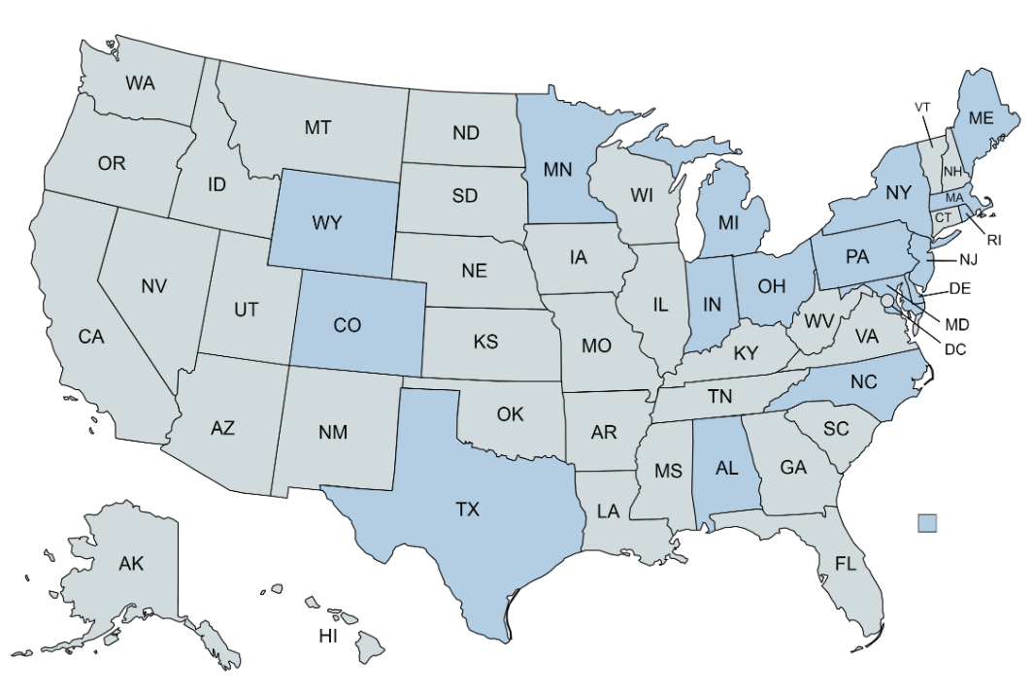
Learning Collaborative State Representation

Slide 15
Questions for the Audience
What are some challenges to enhancing and expanding self-direction? Any success stories you would like to share?
If you could wave a magic wand, what would you wish for to “fix” self-direction?

Slide 16
What Were We Trying to Accomplish?
The Learning Collaborative wanted to enhance the availability, quality, and access to self-direction by:
Disseminating information regarding self-direction, its benefits and how it works
Developing self-direction policies and procedures that are equitable, transparent, flexible, and easily understood and implemented
Enhancing infrastructure to support self-direction
Recruiting and training Direct Support Professionals (DSPs), support brokers, and peer mentors to support self-direction

Slide 17
Reaching the Summit
Team Colorado
Notes:
Presenter: Emily - 15 seconds

Slide 18
Meet the Colorado team
Earning Our Badges….
Meet The Colorado Team
Jessica Corral
Sandy Kasprzak
Emily Harvey
Oliver Giminaro
Day-to-Day Lead
Lead Supporter
Lived Experience Advisor; Reporting Specialist
Implementation Specialist
Kady Predota
Robin Bolduc
Jim McInnis
Jason Smith
Implementation Specialist
Lived Experience Advisor
Support Team Member
Support Team Member
Notes:
Presenter: Emily - 15 seconds

Slide 19
our primary drivers
Reaching the Summit
Our Primary Drivers
Secondary Drivers (Strategies)
Develop culturally appropriate outreach strategies to educate a variety of participants & family members about self-direction.
Educate state & local public managers about self-direction values.
Create accessible guides & supports for participants & families.
Ensure case managers are prepared to embrace self-direction.
Primary Driver
Driver One: Disseminate information regarding self-direction, its benefits and how it works.
Notes:
Presenter: Emily - 1 minute

Slide 20
specific goals and aims
Specific Goals & Aims
Data gathering and analysis
Community partners targeted outreach
ACCOMPLISHED
UNDERWAY
Self-Direction Welcome Kits (CDASS & IHSS)
Case Manager Cafes
Community Educational Workshops
FUTURE
Notes:
Presenter: Emily - 1 minute

Slide 21
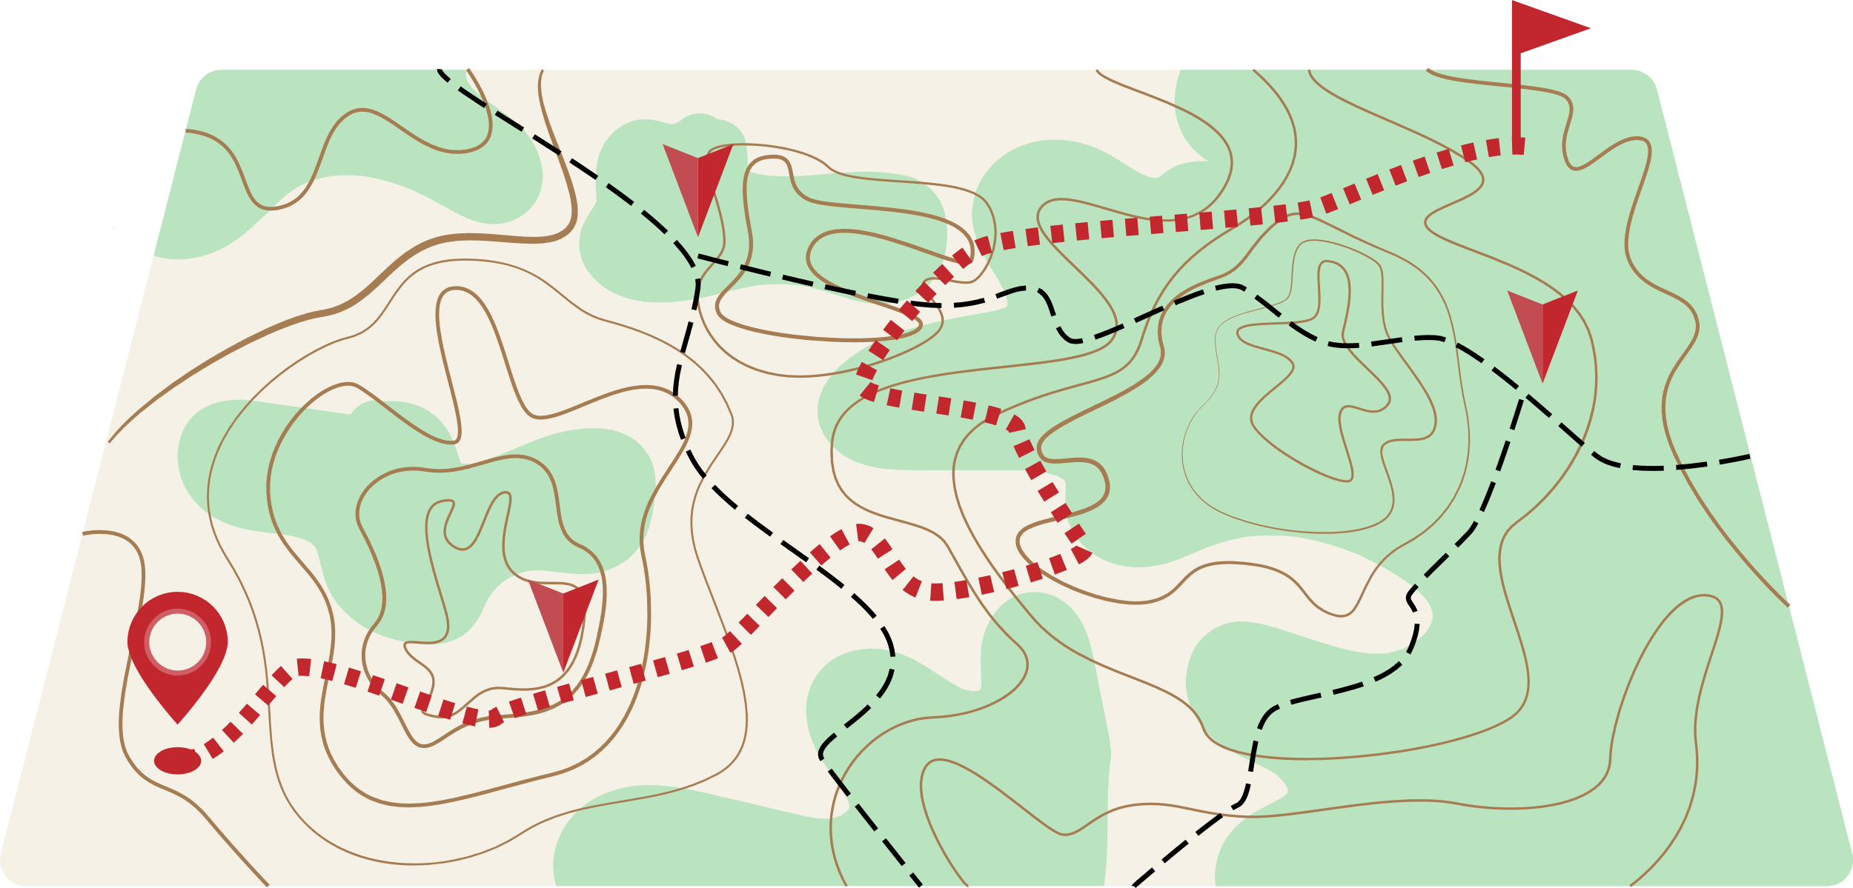
data used to measure progress
Data Our Team Used to Measure Progress
HOW WE MEASURED PROGRESS
Increased use of self direction programs (CDASS and IHSS) get data from Financial Management Service (FMS) providers and Health Care Policy and Financing (HCPF)
BASELINE DATA AND CURRENT DATA
Data from Financial Management Service (FMS) providers and Health Care Policy and Financing (HCPF)
INPUT, PROCESS, & OUTCOME MEASURES
Created and report with graphs and spreadsheets
Notes:
Presenter: Oliver - 3 minutes

Slide 22
diving into the data
DIVING INTO THE DATA
Data Highlights - identifying pinch-points and how to best address them.
Department data by county
Members by county
CDASS & IHSS growth
Case management caseload
Attendant (Caregiver) numbers
Allocation Averages
How did the data drive our initiatives?
Self-Direction utilization is disproportionate throughout the state.
Initial thought: a lack of available resources about self-direction.
Reality: Not a lack of resources, it’s a lack of awareness and understanding of self-direction and HCBS.
Notes:
Presenter: Oliver - 7 minutes

Slide 23
methods: what we did that worked well
What we did that worked well…
Methods
Data Collection
Outreach
Participant Direction has been well established in Colorado for 20+ years.
Original hypothesis was it was a lack of available resources. It was lack of understanding and basic knowledge of Participant Direction
Review Current Materials
Locate where it is housed, how it is disseminated and who has access.
What we tried, but later changed…..
Pivoted from two drivers (Driver 1 and Driver 4) to just Driver 1
Notes:
Presenter: Jessica - 1 minute

Slide 24
lessons learned
Lessons Learned
⮙ COMMIT TO THE LAST LEG ⮙
Implementation can be scary but be bold &
confident. Change comes from action.
🗘 CHECK-IN 🗘
Communicate your capacity & take breaks if
needed. Remember, effective change takes time.
⚒ GATHER SUPPORTS ⚒
Identify who can help & how. Bringing them in
early will ease the lift & spread news quicker.
⛯ CHART THE COURSE ⛯
Collect & assess data to map out what you
want & need to accomplish. Be pragmatic!
Notes:
Presenter: Jessica - 30 seconds

Slide 25
aspirations for the future
Aspirations
for the Future
Work will continue by seeking out a contractor to develop our Welcome Kit.
Maintain gains by continuing data collection & analysis, strengthening & expanding our network, & streamlining current materials.
We want to continue strengthening our network & increasing stakeholder presence.
A goal is to attend state resource fairs to connect with other agencies & community members.
Notes:
Presenter: Jessica - 1 minute

Slide 26
Thank you
Thank You!
Notes:
Presenter: Oliver

Slide 27
"A new frontier (for Ohio) lies not beyond the planets, but within each one of us."
Pierre Trudeau

Slide 28
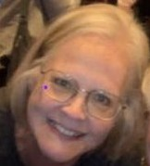
our crew
Our Crew!
Dana Charlton: osda2011@gmail.com
Nathan Turner:
Nathan.turner@dodd.ohio.gov
Sharon Travis: sharon.travis@swocog.org
Renee Wood: babydoe8@aol.com
Steve Oster: soster@knoxdd.com
Lisa Comes: lcomes@oacbdd.org
Nyoka Craddolph: Nyoka.craddolph@dodd.ohio.gov
Jeanne Stuntz: jstuntz@dpioh.com
Nancy Richards: nrichards@clearwatercog.org
Notes:
During the learning collaborative “Our Crew” held the following roles:
Dana Charlton, Day-to-Day Lead, Executive Director, Ohio Self Determination Association (OSDA)
Nathan Turner, Lived Experience Advisor, Ohio Dept. of Developmental Disabilities
Renee’ Wood, Lived Experience Advisor, The Ability Center of Toledo
Steve Oster, Implementation Specialist in local system leadership, Superintendent, Coshocton and Knox County Boards of DD
Lisa Comes, Implementation Specialist, Advisor to local case managers (SSAs) and parents, Ohio Association of County Boards, serving people with DD (OACBDD)
Nyoka Craddolph, Implementation Specialist, State agency leadership, Medicaid Policy Division, Ohio Dept. of Developmental Disabilities
Jeanne Stuntz, Reporting/Data Support, Owner/CEO, Dynamic Pathways, Inc., consulting, training, support brokerage
Nancy Richards, Implementation Specialist, local case managers and system leadership, Clearwater Council of Governments.

Slide 29
The route to self determination
Authority
Responsibility
Self Direction
Self-Determination
Budget Authority
Confirmation
Freedom
Support
Employer Authority
Person Centered Thinking
Support Broker
Supported Decision Making
Supported Living Concept
Notes:
Earth: Ohio’s disability system team entered the NCAPPS Learning Collaborative with a history of self-direction and a
person-centered focus. Since the late 1980s Ohio statute has recognized supported living. This is where two or more
people with disabilities, not related by blood or marriage, can live together in their own home and receive government
support. The home is prohibited from being provider controlled with two exceptions: 1. The owner of the home also
lives in the home with no more than three persons with DD, or 2. The owner is an association of family members and
the property is a home for no more four people with DD. All residents of the home have free choice of provider for
services. The Self Empowered Life Funding (SELF) Waiver was approved in 2011 and requires enrollees to use at least
one self-directed service. Other history includes:
1995 – “Removing the Mask” – Ohio DD Council project for person centered planning
1995 – Project More for supported employment
1997 – Ohio’s Self Determination project funded by RWJ Foundation (Partners: State, Delaware, Knox,
Lucas & Marion Counties)
2011 – SELF waiver approved
NCAPPS Learning Collaborative re-energized Ohio’s self-direction journey to include a greater commitment to
self-determination with increased focus on budget and employer authority, self direction, support broker and
supported decision making.

Slide 30
aims and goals
Aims
&
GOALS
Train DSPs, SSAs, and Peer Mentors
Share information...
Notes:
Primary driver-D1: Disseminating information regarding self-direction, its benefits and
how it works.
Primary driver-D4: Recruit and train plan facilitators (case managers/SSAs) and peer
mentors to assist participants to determine array of services and supports.

Slide 31
BASELINE STATS
(AS OF JULY 2022)
0- No peer network
1837 people used at least 1 self directed service
0 “Views” on self-directed resources
Notes:
Measures – Baselines were 0 for all but #4, as other efforts were started as part of the collaborative:
Increase the number of “views” of self-directed documents and videos on the Dept of DD website
from 0 to 15, 000.
On-going training and education about self-direction will reach a majority of SSA staff in each of
Ohio’s 88 counties.
A peer support network will be established.
Increase the unduplicated number of people using at least one self-directed home and community-
based service by 25%.
Increase the use of support brokerage by waiver enrollees from 15 to 100.

Slide 32
MEASURING SUCCESS
From July 2022 t0 August 2023
Peer network of 21 people meeting for monthly chats on self-direction!
2,482 using 1 Self direction service 35% Increase (645 more).
12,833 “Views” (86% of goal) on self-direction resources
15 publications of "Self-Directed Services Scoop"
1529 SSAs Trained
Notes:
Success as of August 2023:
12,378 / 82.5% of goal –
Increase the number of “views” of self-directed documents and videos on the Dept of DD website from 0 to
15, 000. Views were of multiple resources on self-direction were counted and compared to our baseline.
1,529 case manager/SSAs trained – majority of 2000 SSAs statewide –
On-going training and education about self-direction will reach a majority of SSA staff in each of Ohio’s 88
counties. 15 publications of “Self-Directed Services Scoop” targets local case managers/SSAs, with plans to
continue in the future.
Peer network meets monthly, virtually, with 21 peers on the distribution list.
A peer support network will be established.
2,482 unduplicated people using at least 1 self-directed service – 645 more than 7/2022 baseline of 1,837 (26% more) –
Increase the unduplicated number of people using at least one self-directed home and community-based service by
25%. Data from the Dept of DD from paid claims was used. Department IT staff worked with Ohio’s Team to create
a report that could be updated monthly and sent to the Team.
The existence of the NCAPPS learning collaborative and Ohio’s Team created connections that have been valuable in
addressing the challenges.
6. Have a plan for future work - Increase the use of support brokerage by waiver enrollees from 15 to 100.

Slide 33
CHALLENGES TO PROGRESS:
CRASH AND BURN:
No Support for Support Broker
Took on too much too fast
New FMS
New Self-Directed transportation
3 new self directed services in 1 waiver
Notes:
Challenges to progress/Lessons learned – Ohio took on too much too fast!
Biggest disappointment was no real success in expanding the use of support broker services. In the fall of 2022,
data from the Ohio Dept. of DD showed 3 agencies billing for support broker services to about 20 waiver enrollees.
Only 3 responses were received from a survey that was sent to the 12 providers of support broker services (included
those who had submitted no claims for payment). Views as of July 2023 on support broker resources on the Dept
of DD website, did increase by 215 from August 2022 – gives hopes for the future!
Other lessons learned:
1. A personal invitation is the best way to get someone to participate in a network.
2. Ohio’s FMS and State agency need to improve and simplify systems and processes to better support
self-direction.
3. Transition from one FMS to another should include a period of overlap to be “seamless” to the waiver
enrollee and better coordinate process.
4. Training on self-direction for people with disabilities and families needs to include the meaning and
benefits of self-direction, how it can exist even without HCBS waiver services and tips on ways to
“empower” yourself – e.g. submit your own agenda for your planning meeting/discussion.
5. Don’t include auditors in brainstorming and rule interpretation discussions – give them the bottom line.
6. Too much, too fast and the resulting confusion does not send a very positive message about self-direction.
7. It is possible for support broker and participant-directed homemaker/personal care services to work
through an agreement with the FMS when the provider is an individual (not an agency). This could simplify
the process of certification of individuals as providers.
8. Little is generally known and understood about self-direction by the majority of case managers/SSAs,
people with disabilities and families. Few recognize the term self-direction unless it is associated with
choice and greater control.

Slide 34
blasting off toward the future
TOWARD THE FUTURE!
BLASTING OFF
Budget
Authority
Grow the network
Simplify Provider Cert.
Keep the Team
Employer Authority
Support Broker
Notes:
Though engagement with the NCAPPS Learning Collaborative is coming to an end, the Ohio Self-Direction Team will
continue to work together. Future efforts include:
More education, resources and use of budget and employer authority, self-direction and understanding of its benefits.
Growing Ohio’s network of peer mentors.
Improvements in Ohio’s system of HCBS waiver services to include support broker and a simplified provider
certification process for providers of those who choose self-direction.
Expansion of Ohio’s Self-Direction Team
Hoping for future opportunities to collaborate on self-direction.

Slide 35
“A new frontier (for Ohio) lies not beyond the planets,
but within each one of us.” -- Pierre Trudeau

Slide 36
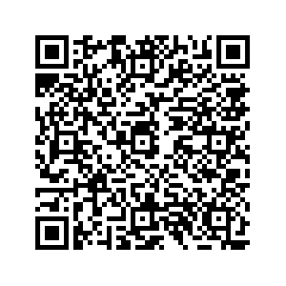
New NCAPPS Resource: A Guide for Developing Strategic Objectives to Expand Self-Direction
The Guide offers a road map to strategic targets that are linked to the key drivers of a robust self-direction option within public programs. It lays out a series of decision points beginning with the selection of overarching goal(s) to pursue, aspects of the goal to tackle, and actions steps to pursue.
The road map is based on the Self-Direction Learning Collaborative Change Package.

Slide 37
How to Use the Strategic Objectives Template
Consult with people receiving services, family members and others regarding the conduct of self-direction in the state
Conduct an environmental scan to identify gaps and areas for improvement including political and financial feasibility
Select One or More Strategies
Chose a Secondary Strategy
Identify Action Steps
Create a Measurement Strategy

Slide 38
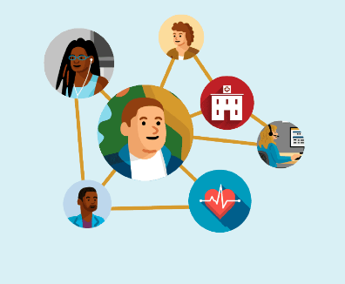
Primary Strategies
Disseminate information regarding self-direction, its benefits and how it works.
Develop self-direction policies and procedures that are equitable, transparent, flexible, and easily understood and implemented.
Enhance infrastructure to support self-direction.
Recruit and train Direct Support Professionals, support brokers, and peer mentors to support self-direction.
Credit: Medisked

Slide 39
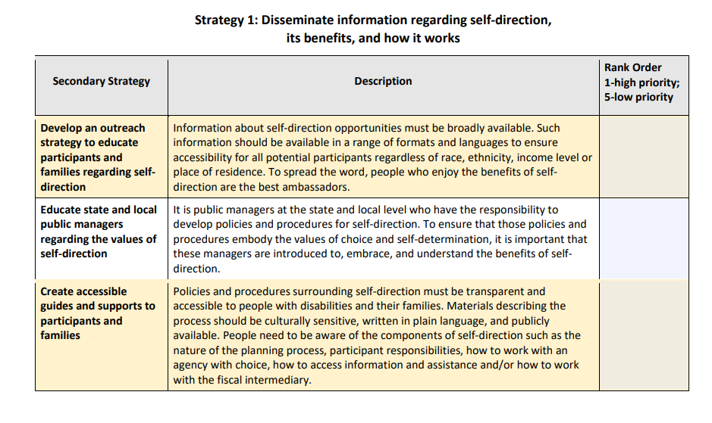
Table example 1

Slide 40
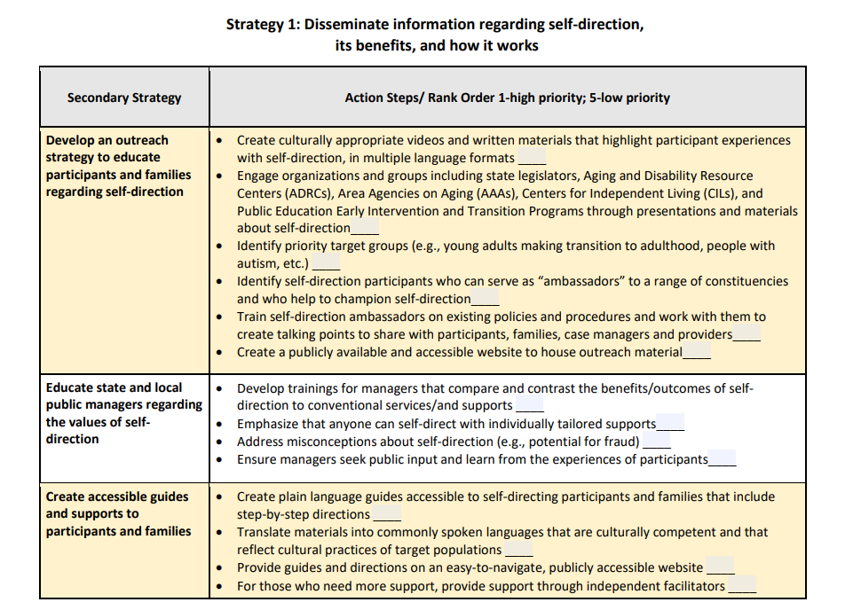
table example 2

Slide 41
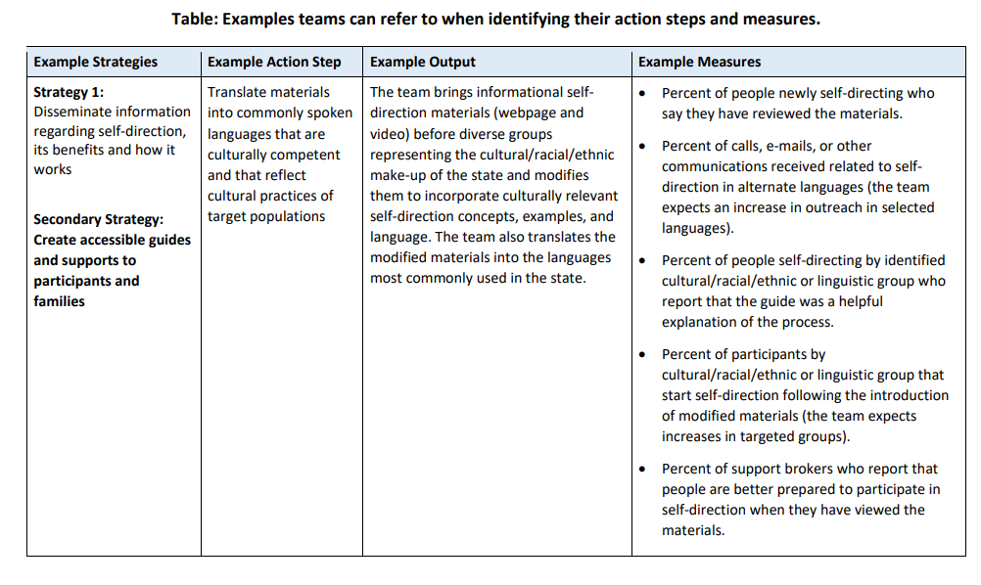
table example 3

Slide 42
Questions?

Slide 43
Real-Time Evaluation Questions
Please take a moment to respond to these six evaluation questions to help us deliver high-quality NCAPPS webinars.
If you have suggestions on how we might improve NCAPPS webinars, or if you have ideas or requests for future webinar topics, please send us a note at NCAPPS@hsri.org

Slide 44
Real-Time Evaluation Questions (cont.)
Overall, how would you rate the quality of this webinar?
How well did the webinar meet your expectations?
Do you think the webinar was too long, too short, or about right?
How likely are you to use this information in your work or day-to-day activities?
How likely are you to share the recording of this webinar or the PDF slides with colleagues, people you provide services to, or friends?
How could future webinars be improved?

Slide 45
Thank You.
Website: ncapps.acl.gov
Email: ncapps@hsri.org
Notes:
Notes Page Title Here
(edit this in notes view)

