Slide 1
Pathways to Person-Centered Decision-Making and Alternatives to Guardianship
June 21, 2022
Notes:
Notes Page Title Here
(edit this in notes view)

Slide 2
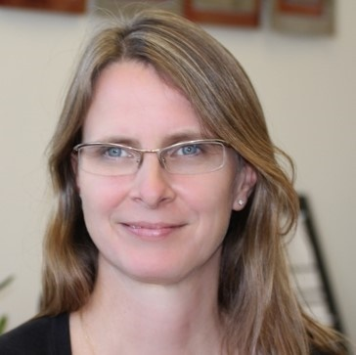
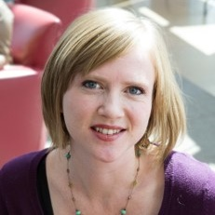
Welcome to Today’s Webinar
Thank you for joining us to learn about how disability systems are expanding alternatives to guardianship.
This webinar series is sponsored by the National Center on Advancing Person-Centered Practices and Systems (NCAPPS). NCAPPS is funded by the Administration for Community Living (ACL) and Centers for Medicare & Medicaid Services (CMS).
NCAPPS webinars are free and open to the public.
Alixe Bonardi
Bevin Croft
abonardi@hsri.org
bcroft@hsri.org
NCAPPS Co-Director
at HSRI
NCAPPS Co-Director
at HSRI
Notes:
Notes Page Title Here
(edit this in notes view)

Slide 3

The goal of NCAPPS is to promote systems change that makes person-centered principles not just an aspiration but a reality in the lives of people across the lifespan.

Slide 4

Webinar Logistics
Participants will be muted during this webinar. You can use the chat feature in Zoom to post questions and communicate with the hosts.
Toward the end of the webinar, our speakers will have an opportunity to respond to questions that have been entered into chat.
The webinar will be captioned in English and Spanish.
  To access the English captions, please use this link: https://www.streamtext.net/player?event=HSRI
  To access the Spanish captions, please use this link: https://www.wordshare.com/player/HSRI-2
  El seminario de web estará subtitulado en vivo en Inglés y Español. Para tener acceso a los subtítulos en Español, utilice este enlace: https://www.wordshare.com/player/HSRI-2
This live webinar includes polls and evaluation questions. Please be prepared to interact during polling times.

Slide 5

Feedback and Follow-Up
After the webinar, you can send follow-up questions and feedback about the webinar to NCAPPS@hsri.org.
(Please note that this email address is not monitored during the webinar.)
The recorded webinar, along with a PDF version of the slides and a plain language summary, will be available within a few weeks at NCAPPS.acl.gov. We will also include questions and responses in the materials that are posted following the webinar.

Slide 6
Who’s Here?
“In what role(s) do you self-identify? Select all that apply.”
Person with a disability/person who uses long-term services and supports
Family member/loved one of a person who uses long-term services and supports
Self-advocate/advocate
Peer specialist/peer mentor
Social worker, counselor, or care manager
Researcher/analyst
Community or faith-based service provider organization employee
Government employee
(federal, state, tribal, or municipal)

Slide 7
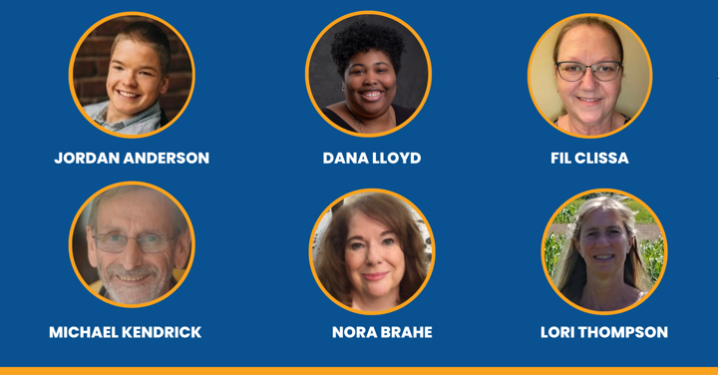
Meet Our Speakers

Slide 8
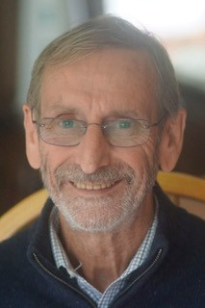
Michael Kendrick

Slide 9
Person-Centeredness:
Getting Back to the Center
Dana Lloyd
Georgia Advocacy Office
dlloyd@thegao.org

Slide 10

If I have seen further, it is by standing on the shoulders of giants
Notes:
Often women Beth Mount Katie Chandler Leslie Lipson John Obrien Michael Smull Jack Pearpoint, I’m sharing their concepts in ways that have resonated with me.

Slide 11

where do you see institutional control show up in people's lives?
Ivanova Smith
Disability Civil Rights Advocate
Notes:
Institutions are not only places, group homes personal care homes can be intuitions where do you see institutional control show up in peoples lives

Slide 12

One Question
Who is the person and
what do they need?
  Not a diagnosis or a label but the person as a human
  Not a service need a fundamental human need
  These answer would be true for anyone

Slide 13




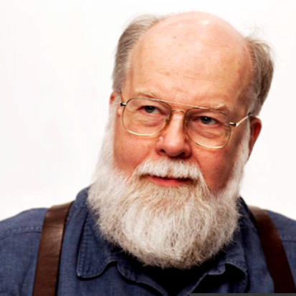
What is Person Centeredness?
Notes:
Stop at after John O’brien 1:28

Slide 14

Moving away from a past characterized by:
Isolation, seclusion, and separation by location, activities, and schedule
Rejection, loneliness, always on the outside, ignored
Old stories, negative reputation labels; negative self-fulfilling prophecies
Limited voice, restriction, lack of representation, no power,
Unproductive, severely ignored, undeveloped; no resources, low expectations
Will our choices reinforce old patterns of isolation, rejection, powerlessness, and poor reputations?
John O’Brien and Connie Lyle O'Brien
Notes:
People’s experiences…look at where people have been - what our services have typically provided.
which of these do you see the most currently with folks you work for?
Safe zone, calling this out so we can all acknowledge our part in it.

Slide 15
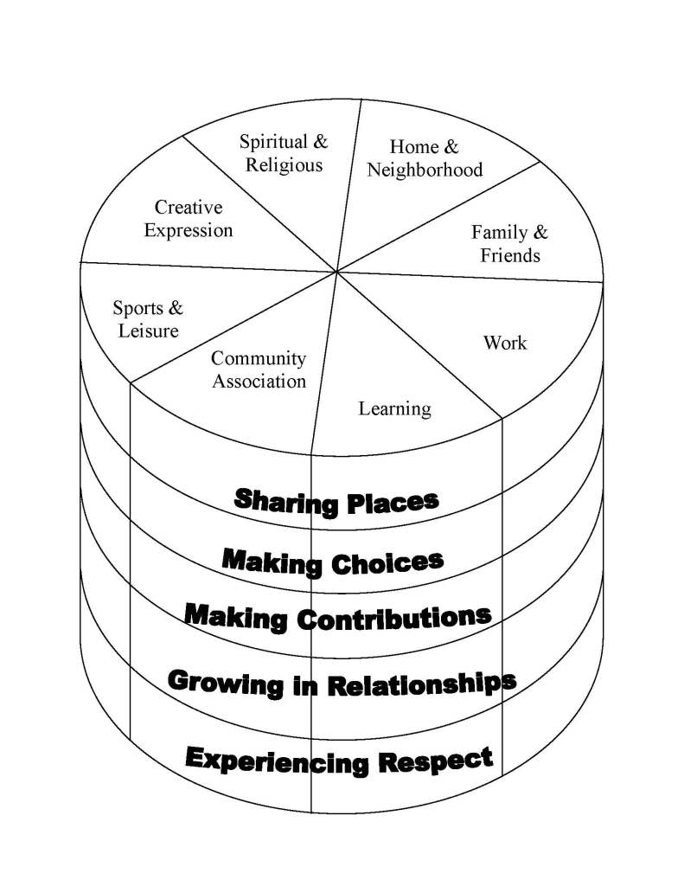
FIVE VALUED EXPERIENCES
EIGHT SECTORS OF
COMMUNITY LIFE

Slide 16

    How do we support people to create a good life, a life well lived?
• Recognize REAL choice is important
• Each person is treated with dignity & respect
• Natural supports/friendships & relationships are needed & vital
• Create opportunities for communication and for folks to be heard
• Create opportunities for community involvement
• Acknowledge that people are more alike then different
• Create opportunities to experience life
• Create opportunities for life to be joyful and productive
Notes:
Dignity and respect go back to your memory

Slide 17

Ask a Different Question
Notes:
If I ask do you want chocolate or strawberry, you are stuck with those choices…

Slide 18

let's talk about dignity of reasonable risk
Notes:
But if it ask what’s your favorite flavor of ice cream a variety of options open up. Sometimes we get stuck in binary “either/or” thinking and we offer people ‘service options’ instead of finding out what they want and need and building services around that. While the ice cream is here let's talk about dignity of reasonable risk (cereal or ice cream for dinner)

Slide 19
Supported Decision-Making Person Centeredness
Person Centeredness
Supported Decision-Making
Person Centeredness
Supported Decision-Making is both a result of
AND
a tool to promote greater Person Centeredness
Notes:
So when we shift our thinking ask different questions, focus on real choice and real opportunities we see a natural flow into supported decision making, which in some sense is person centered planning in the real world and not just at your annual bureaucratic moment. SDM asks the question what would it take for a person to be supported in their decision making, what support might they need to have more choice and control and autonomy in their life?

Slide 20
DECIDE
I DECIDE helps highlight the most important parts of Supported Decision-Making.
When people are engaged in this way it is person-centered by nature.
Notes:
In our supported decision-making project we use the Phrase I Decide and the acronym to emphasize the important components of SDM

Slide 21
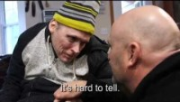
It’s Possible
Notes:
This is story from Washington state that I think shows these principles in action.

Slide 22

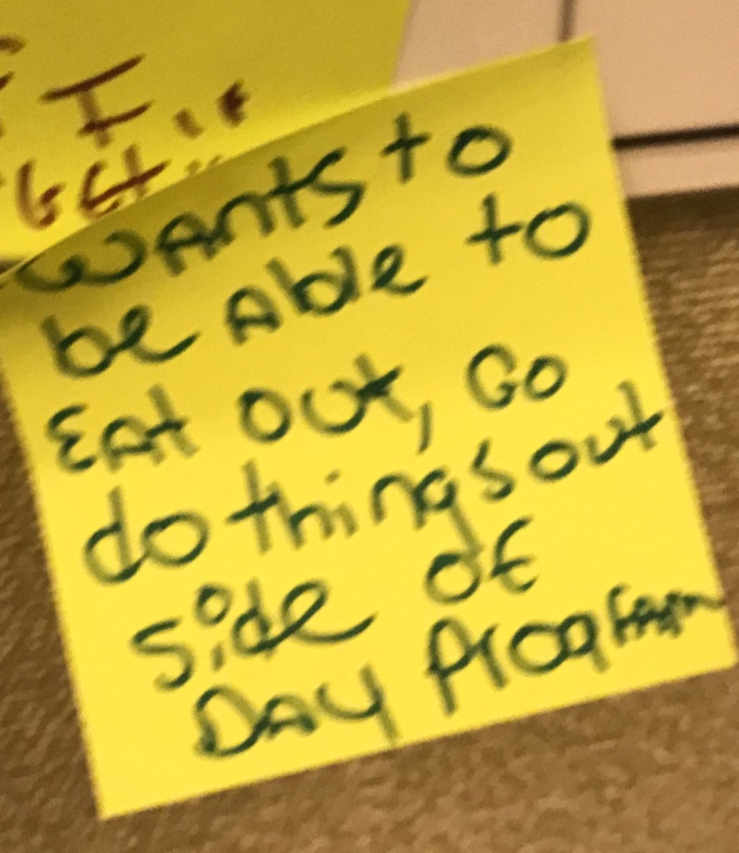
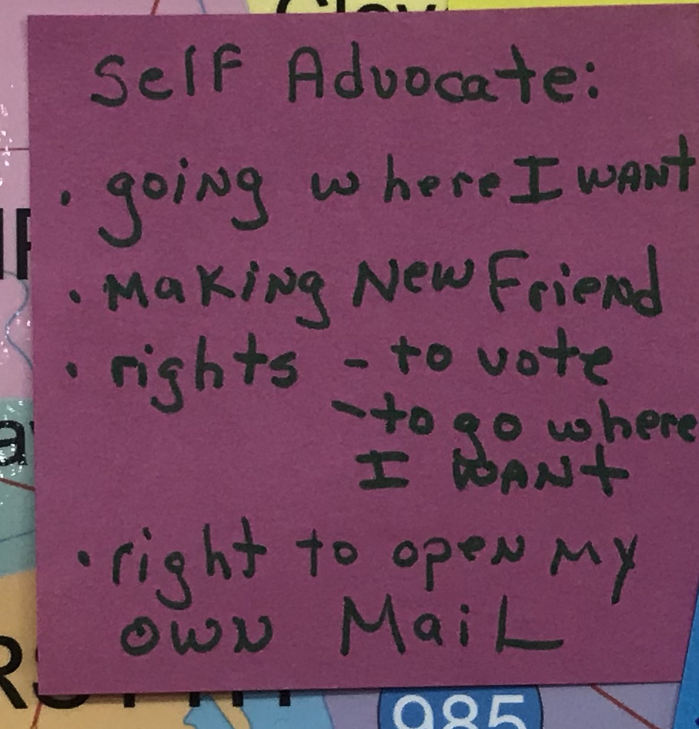
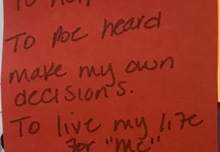
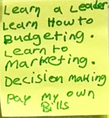
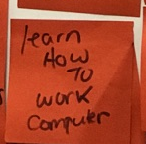
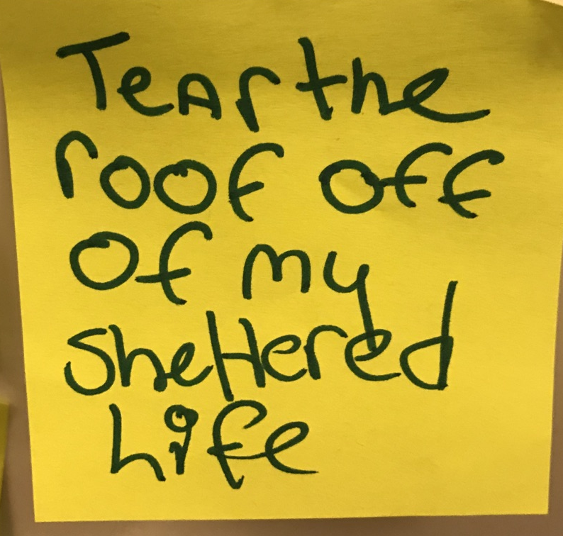
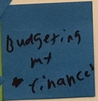
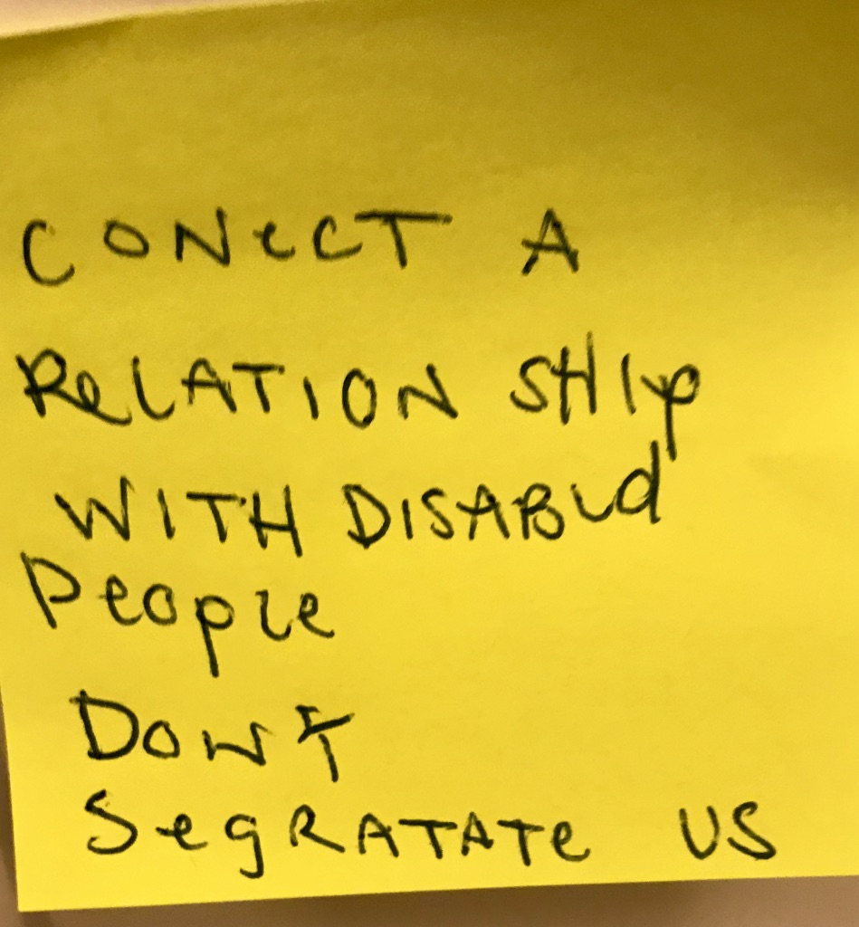
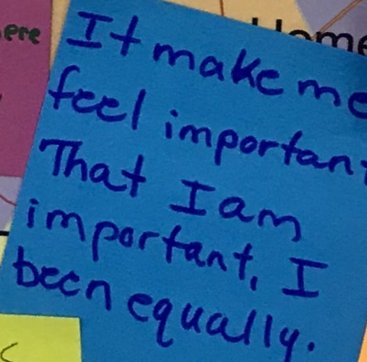
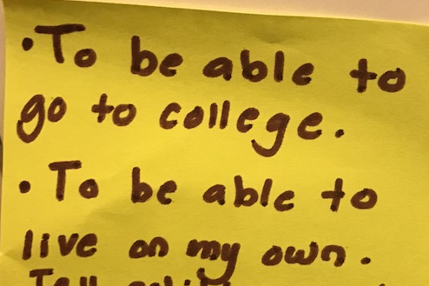
What I want, what I wish was different:
written by self-advocates
Notes:
People deeply desire more choice and control in their lives and the ways they are sheltered and constrained by services. In some ways you just need to remember this list and all the ordinary things people want, no one said a cruise or a Hawaiian vacation it’s the simple everyday ways we

Slide 23
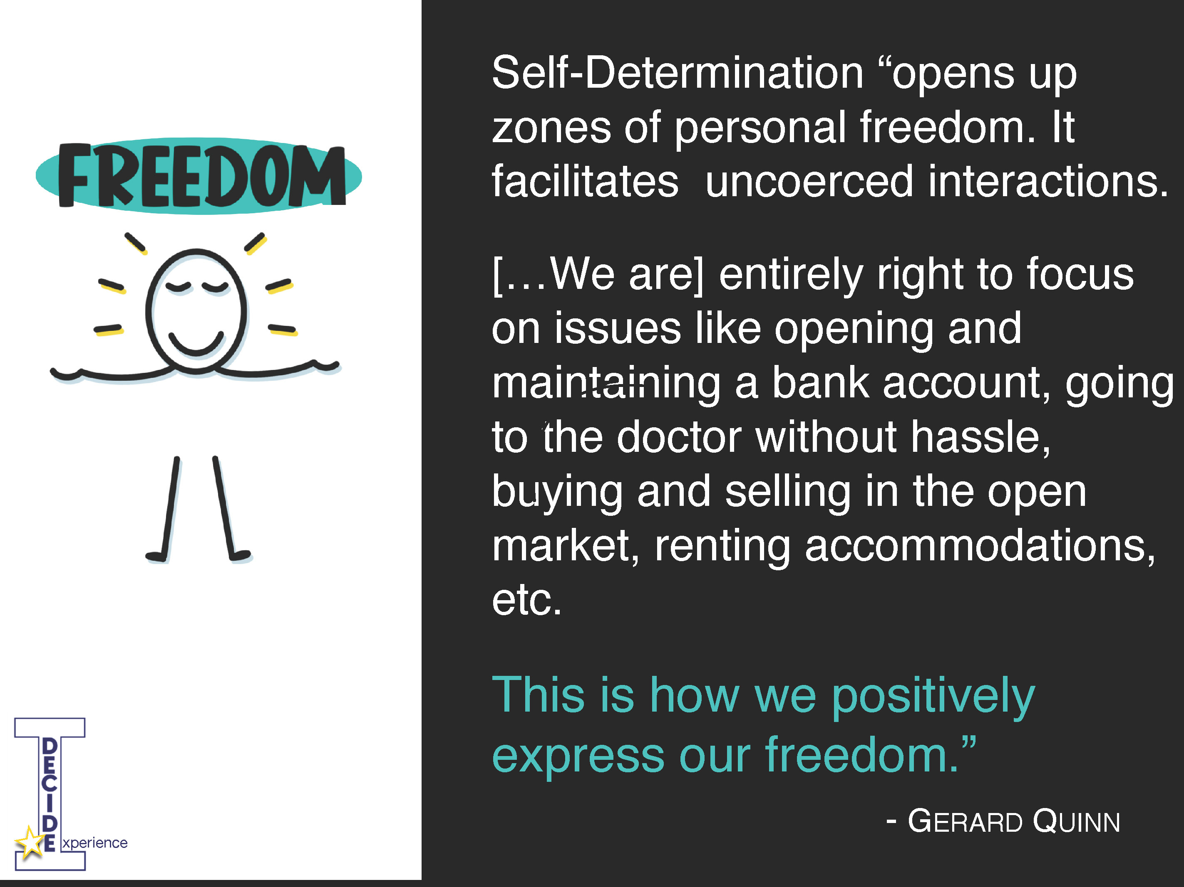
Zones of personal freedom

Slide 24
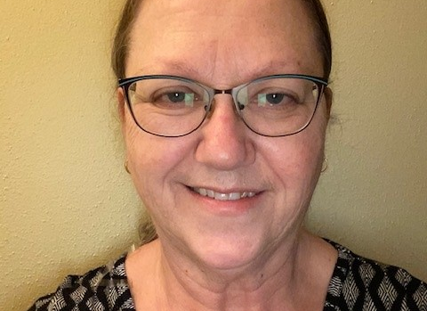
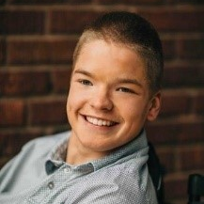
Jordan Anderson and Fil Clissa

Slide 25
Using SDM in Personal Life
Housing
Finances
Health Care
Leisure Time
Education, Employment

Slide 26
SDM Process
Decision Maker
Supporters
Types of Decisions
Types of Supports
Plan

Slide 27
The Role of Supporters
Supporters should be individuals that the person knows and trusts to provide the type of support they want for the types of decisions they want to make.
The Person Can
  assign certain supporters to certain types of decisions and not others.
  have as many supporters as they wants.
  fire their supporters at any time, and supporters have the option of quitting.

Slide 28
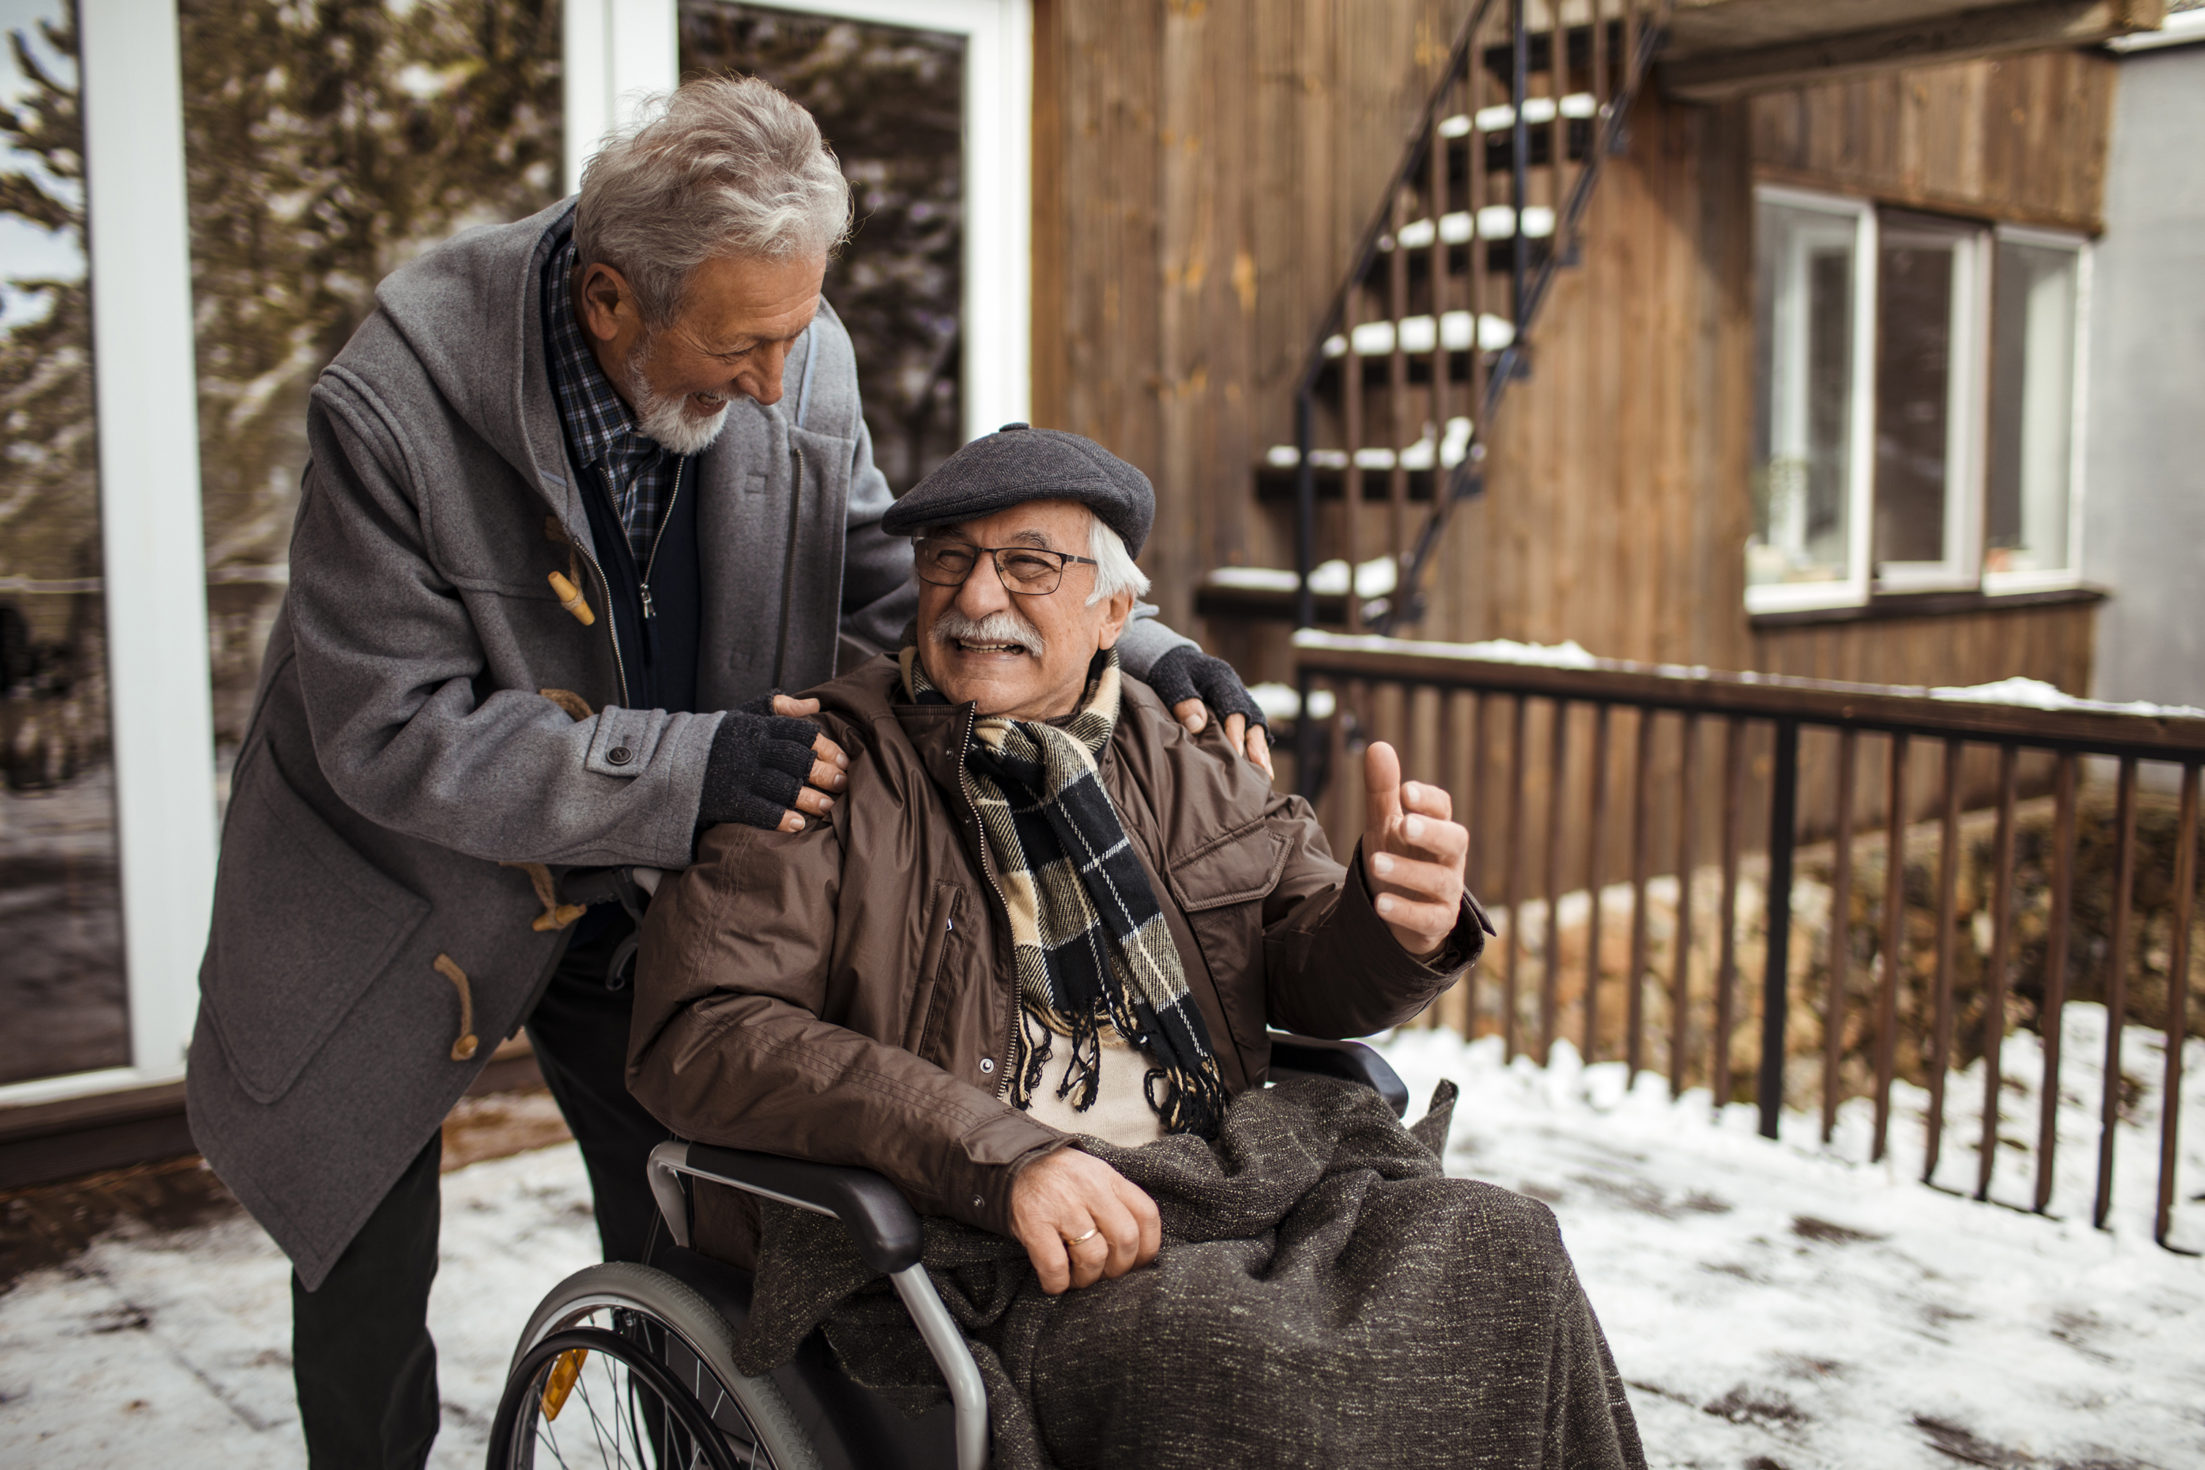
Building a Supportive Relationship
Consider the individual’s wishes first
Provide the least restrictive form of support
Allow for growth and maturity as a person experiences and practices new skills
Talk about respect and boundaries
Expect differences of opinion and world view
Make room for change
Focus on the present and future
Think about how to disagree

Slide 29
Colorado’s Efforts to Enhance SDM
Speak Up Classes
Person-Centered Thinking Trainers Meetings
Colorado Developmental Disabilities Council: Self-Determination & Supported Decision-Making Guide
Senate Bill 21-075

Slide 30
Moving Forward in Colorado
Building partnerships to increase the number of individuals who have more control over their lives
Provision of PCP training for all HCBS case managers
Integrating PCP into transition coordination training
Developing SDM training for HCBS providers and members
Designing and implementing an exploratory project that will be conducted with a designated group of HCBS members and providers to learn and practice SDM training.

Slide 31

Questions?

Slide 32
Real-Time Evaluation Questions
Please take a moment to respond to these six evaluation questions to help us deliver high-quality NCAPPS webinars.
If you have suggestions on how we might improve NCAPPS webinars, or if you have ideas or requests for future webinar topics, please send us a note at NCAPPS@hsri.org

Slide 33
Real-Time Evaluation Questions pt. 2
Overall, how would you rate the quality of this webinar?
How well did the webinar meet your expectations?
Do you think the webinar was too long, too short, or about right?
How likely are you to use this information in your work or day-to-day activities?
How likely are you to share the recording of this webinar or the PDF slides with colleagues, people you provide services to, or friends?
How could future webinars be improved?

Slide 34
Resources
Supported Decision-Making and Guardianship Alternatives (Wisconsin Board for People with Developmental Disabilities)
https://www.openfuturelearning.org
https://www.cclds.org
https://lipsonadvocacy.com/offerings
Colorado Developmental Disabilities Council: Self-Determination & Supported Decision-Making Guide
Senate Bill 21-075

Slide 35
Thank You.
Register for upcoming webinars at
ncapps.acl.gov
Notes:
Notes Page Title Here
(edit this in notes view)

