Slide 1
Planning for Quality Improvement
A Presentation to the World Health Organization Symposium on Quality Improvement
H. Stephen Leff, Ph.D.
Department of Psychiatry, Harvard Medical School at Cambridge Health Alliance
Human Services Research Institute
November 2, 2012

Slide 2
World Health Organization Planning Guidance Package – A useful introduction to mental health planning
http://www.who.int/mental_health/policy/en/policy_plans_revision.pdf

Slide 3
Visions must be translated into plans with specific and quantitative goals and objectives, strategies, targets and related quality improvement processes

Slide 4
Stakeholders experience and may be responsible for different aspects of quality in different contexts
A Policy Ecology of Implementation.
Raghavan, R., C. L. Bright, et al. (2008). "Toward a policy ecology of implementation of evidence-based practices in public mental health settings." Implement Sci 3: 26

Slide 5
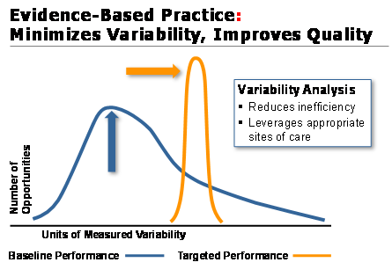
What is Quality: Improves Practice, Minimizes Variability
질 향상
What Is Quality:

Slide 6
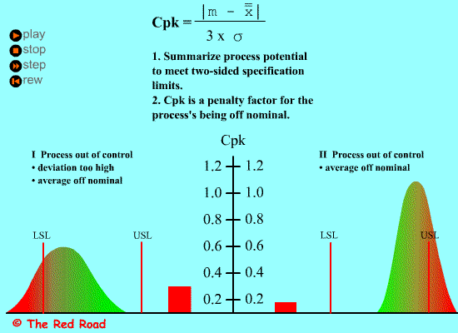
Improving quality animation
Quality Improvement:
Outcomes Is Moved into Desired Range and Variability Minimized
Acceptable Variability; Outcomes Is Moved into Desired Range

Slide 7
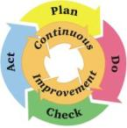
Quality Improvement Is a Process: Common Representation of Continuous Quality Improvement Process (PDCA)
소비자/환자
질 향상
욕구사정
이용 가능한 자원
현실적 목표
정신보건서비스
정책
지침
시스템 모니터링
욕구충족
성과

Slide 8
The Importance of Planning to Quality Improvement according to the World Health Organization
To be effective, a vision needs “a detailed plan so that…[it] can be implemented in a systematic and well-coordinated way.”

Slide 9

“PLAN:” Quality improvement provides the arrows, A high quality plan provides the target; Several arrows indicate different quality improvement practices for different contexts

Slide 10
Mental Health System Planning: Like Putting Puzzle Pieces Together
Notes:
From an administrator’s perspective planning a mental health system is like putting together a puzzle. Here are some of the puzzle pieces (Puzzle pieces fly in as in case mix adjustment toolkit animation):
What types and numbers of consumers does your system have to serve (Puzzle Piece: Consumers)?
What types and amounts of services do they need (Puzzle Piece: Services)?
How will consumers’ service needs change over time as a function of service outcomes (Puzzle Piece: Outcomes)?
What will the services consumers need cost, taking into account consumers’ changing service needs (Puzzle Piece: Costs)?
What revenues will be generated by services (Puzzle Piece: Revenues)
What are the total resources available to the system (Puzzle Piece: Total Resources)?
These puzzle pieces are all variables in the HSRI Planning and Allocation Model. I’ll return to how we measure these variables later.
Now this puzzle has to be flexible in some ways that other puzzles don’t.
Often the Total Resources Piece is too small to fit with the rest of the puzzle. (Show Total Resources Piece that is too small to fit and not fitting.)
Of course, we’d like to make it bigger. (Show Total Resources Piece growing and then fitting.)
But sometimes we are forced to make the other pieces smaller. The other pieces we usually have control over are the Consumer Piece and the Services Piece. We can change one (Show Service Piece getting smaller, thereby reducing other Puzzle Pieces so that Total Resources now fits) or both of these (show Service Piece and Consumer Piece getting smaller so that all pieces get smaller and Total Resources now fits).
Sometimes we want to redesign a system. Implementing evidence-based practices is redesigning a system (as is closing hospital beds). You might think of it as simply adding services. But we think it will really involve substituting some services for others and making entire sets of new demands on a system. (Show Services Puzzle Piece changing its shape so it no longer fits.) So when you add evidence-based practices you usually will have to redesign your system in other ways (Outcomes, Costs, Revenues, and Resources Pieces all change to create a different picture).
Sometimes you will want to explore several possible re-sizing or redesign strategies as a part of deciding what policies to follow. You could for example try several different ways of changing the services piece (for example adding different EbPs) and see what other changes would have to be made. Then you could make your decision on the basis of likely costs, outcomes, etc.

Slide 11
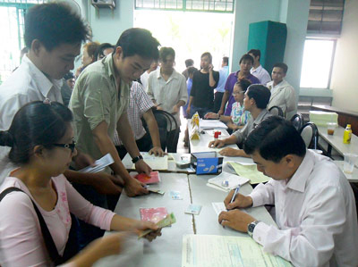
Planning Begins with System Participants (Stakeholders) Identifying Goals and Values
정책

Slide 12
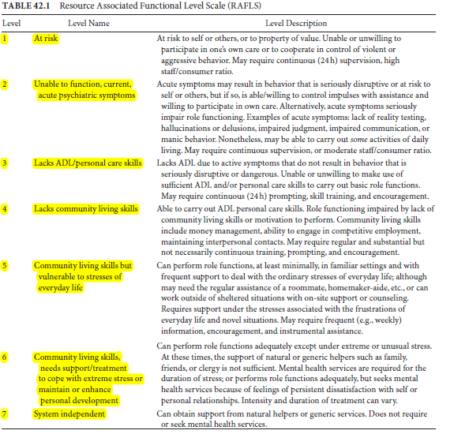
Quality Begins and Ends with Consumer: Example of a Functional Level Scale For Needs Assessment
기능수준

Slide 13
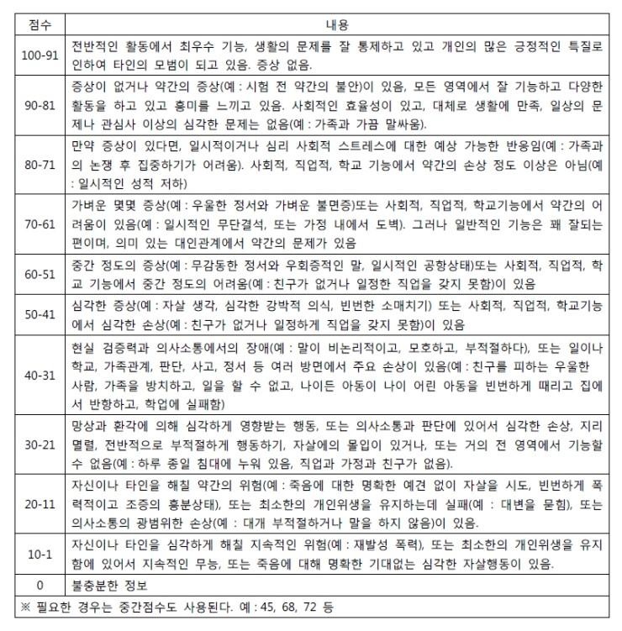
Another Example of a Functional Level Scale For Needs Assessment: Global Assessment of Functioning Scale

Slide 14
Example of Instrument for Translating Functional Levels into Service Needs - 서비스 계획 및 평가 조사
기능수준
RAFLS Rating
정신보건서비스

Slide 15
Another Example of Instrument for Assessing Service Needs: The Camberwell assessment of needs (욕구사정 ) short appraisal schedule
정신보건서비스

Slide 16
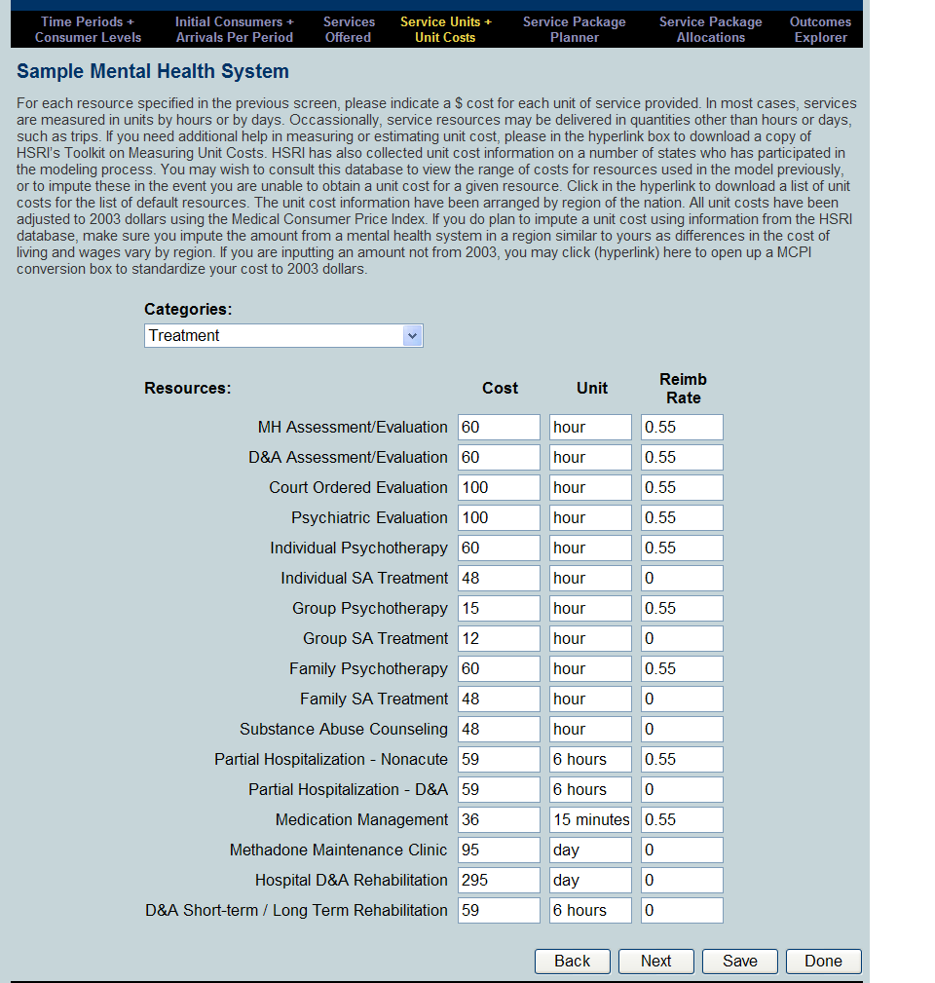
An Example of an Instrument for Measuring Services and Unit Costs
서비스 비용
정신보건서비스
Notes:
This is another screen shot from our web based application. This is the area of the model where you would enter the unit costs by service. There is also a column to enter the reimbursement rate. For example, if a service is covered by Medicaid, you may insert the federal share of the service in this column. This will be helpful in order to compute net state costs in the results section of the model.

Slide 17

Monitoring Transitions Between States: Particularly Useful Way to Measure Outcomes for Planning - 성과
Functional Level 3
기능수준
Receive service
정신보건서비스
근거기반실천 / 근거기반진료
Current System
EbP System
FL1
FL2
FL3
FL4
FL5
FL6
FL1
FL2
FL3
FL4
FL5
FL6
5
10
65
15
5
10
60
20
5
5
Transition probabilities (추이확률)
Notes:
The simulation uses observed rates of transition between functional levels to estimate changes in need due to changes in consumer status over time. The animation on this slide shows that different service packages result in different outcome. In this example you are seeing a system that implements EbPs into their system is showing higher functioning or better outcomes for that group.
The way the model computes this is associated with every combination of service package and functional level is a probability distribution giving the percentage of consumers in the given functional level that move to other functional levels after receiving the service package for one time period. These transition probabilities can be considered measures of the service package’s effectiveness.
The simulation model is sensitive to the dynamic flow of real mental health systems in assuming that, as services are given, some consumers will improve in functioning, while others will deteriorate or remain static. As consumer functioning fluctuates, the model generates information about who is using resources, how they are responding to the treatments available, and how these shifts affect the overall cost of the system.
These Markov transition rates are a result of synthesizing the evaluation literature of mental health systems.
This was not shown on the animation, however, the transition rates also take into account that people leave the service system for a variety of reasons. It is possible they could die or disappear from the system because of moving out of the area, dissatisfaction with the services, eligibility issues, etc. The model takes these movements out of the system into consideration.

Slide 18
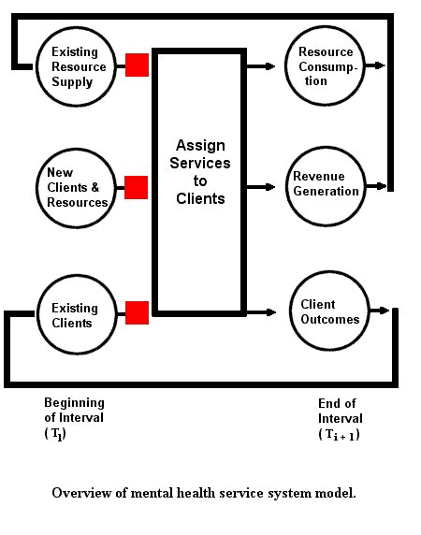
Computer Simulation Makes It Possible to Project Service Utilization, Outcomes, Service and System Costs Over Time
C
역동적 시뮬레이션 모델
서비스 비용
이용 가능한 전체 자원
정신보건서비스
기능수준
성과
시점
시점

Slide 19
Examples of Plan Results Produced by Simulation
근거기반실천 / 근거중심진료
정신보건서비스

Slide 20
“CHECK:” Monitoring System Performance – “Vital for Improving…”
국가정신보건정책과 계획에 대한 주의 깊은 모니터링과 평가는 서비스, 치료, 관리수준을 향상시키고 미래의 정책방향을 제시하기 위해 필수적인 것이다.
세계보건기구

Slide 21
Comparing Observed (“DO”) to Planned Results Starts the PDCA Quality Improvement Cycle Again 시스템 모니터링 : 욕구충족
정신보건서비스

Slide 22
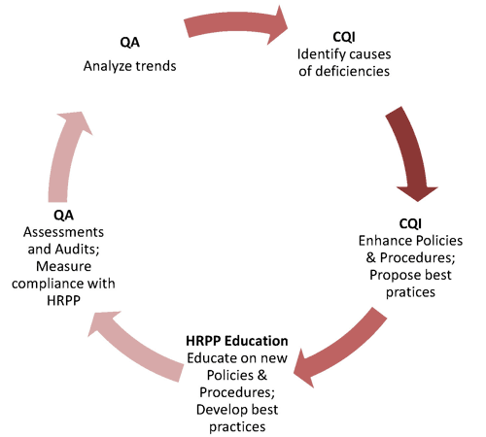
The Link Between “Change Plan” and “Do:” Training
Change Plan
훈련
(Training)
Act
Check
Do

Slide 23
Examples of Plan Results Produced by Simulation
근거기반실천 / 근거중심진료
정신보건서비스

